Slide 1
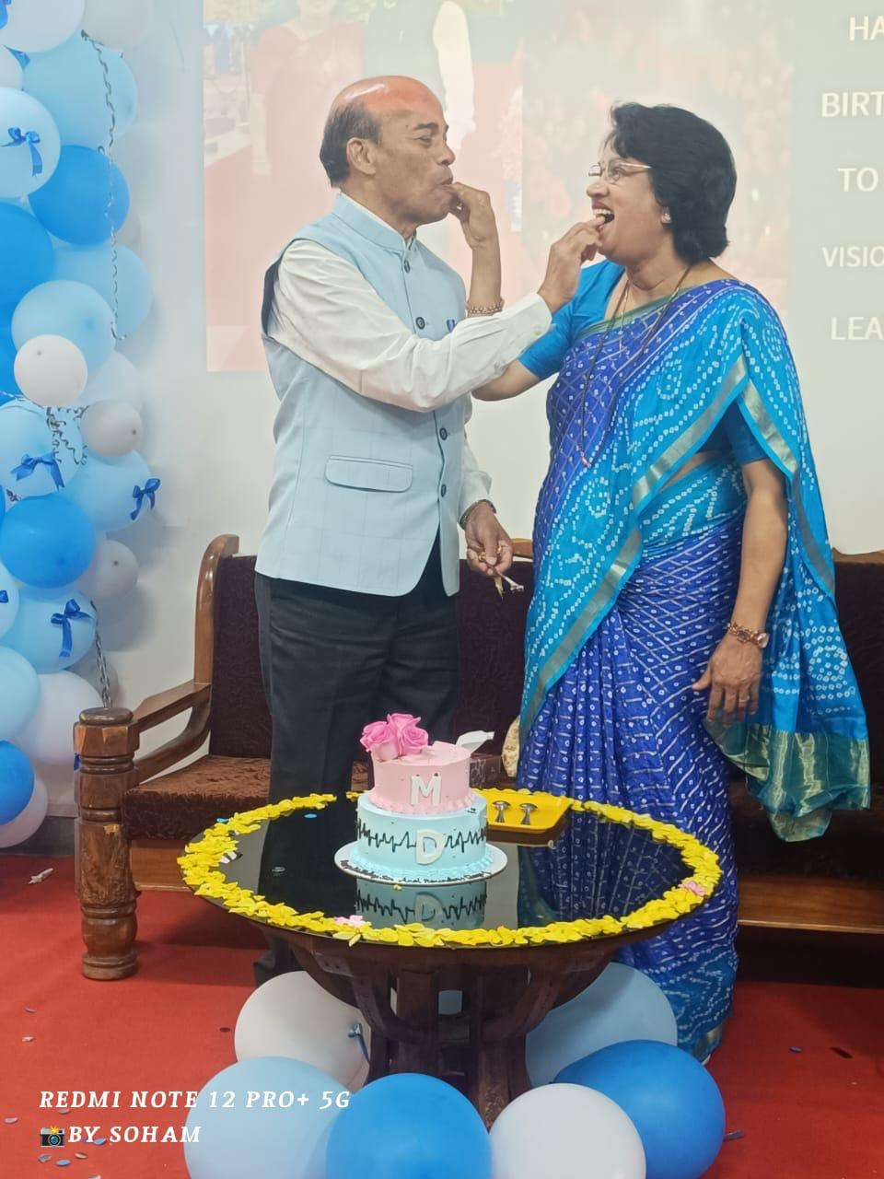
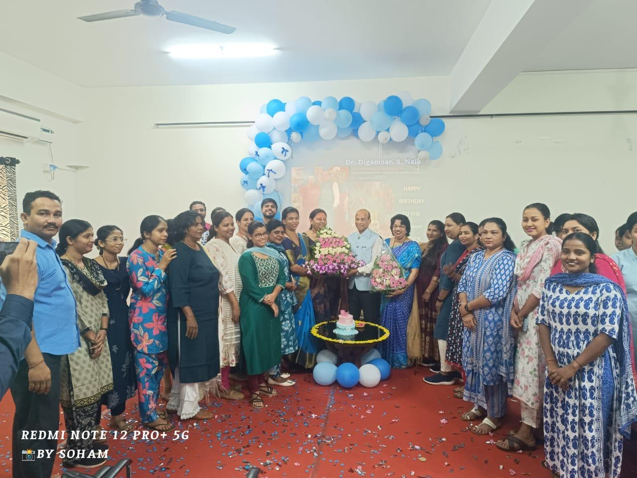
On 5th April, members of the Club celebrated Wedding Anniversary of Ln Dr Digamber Naik and Ln Mangala Naik. During this function, Ln Dr Digamber during this event, Ln Dr Digamber delivered talk on How to serve the needy

Slide 2
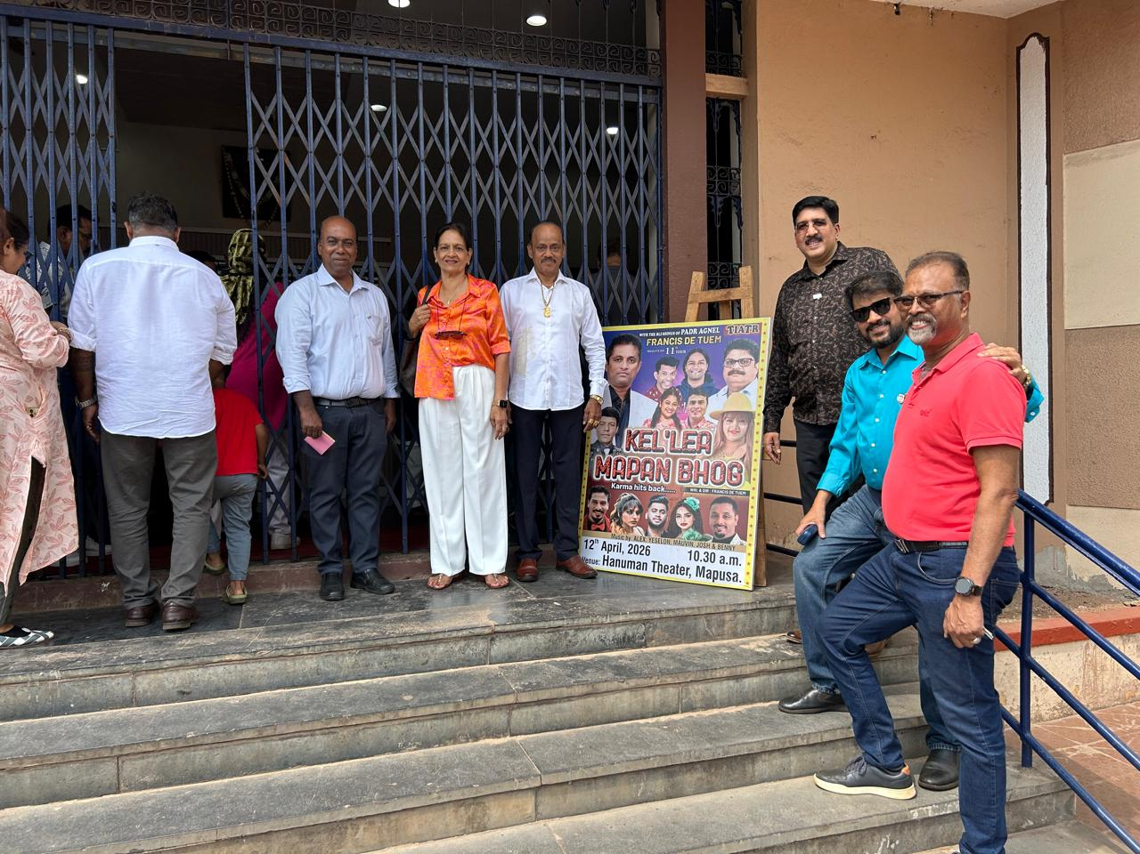
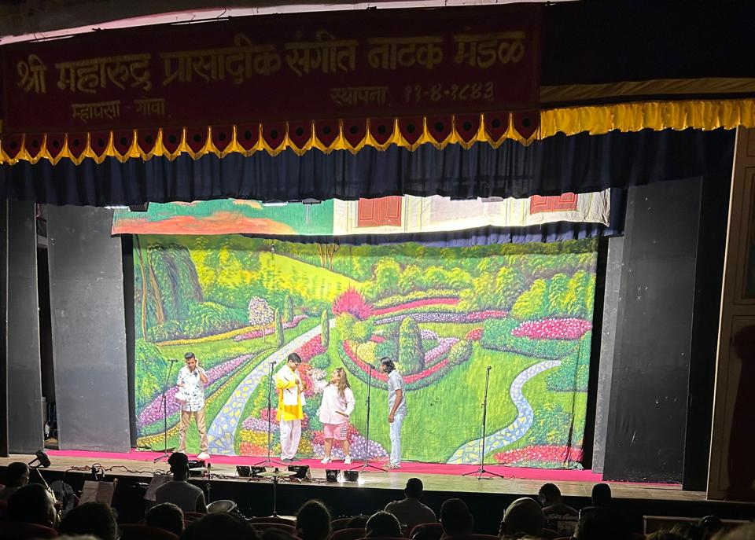
Registered, Participated and Motivated the committee of Lions Club of Mapusa Elite and also attended tiatra.

Slide 3
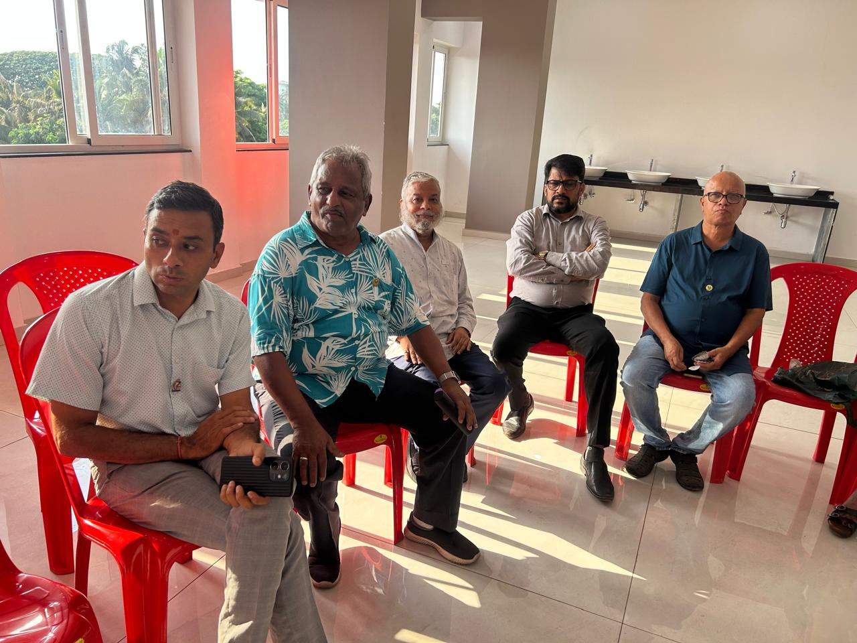
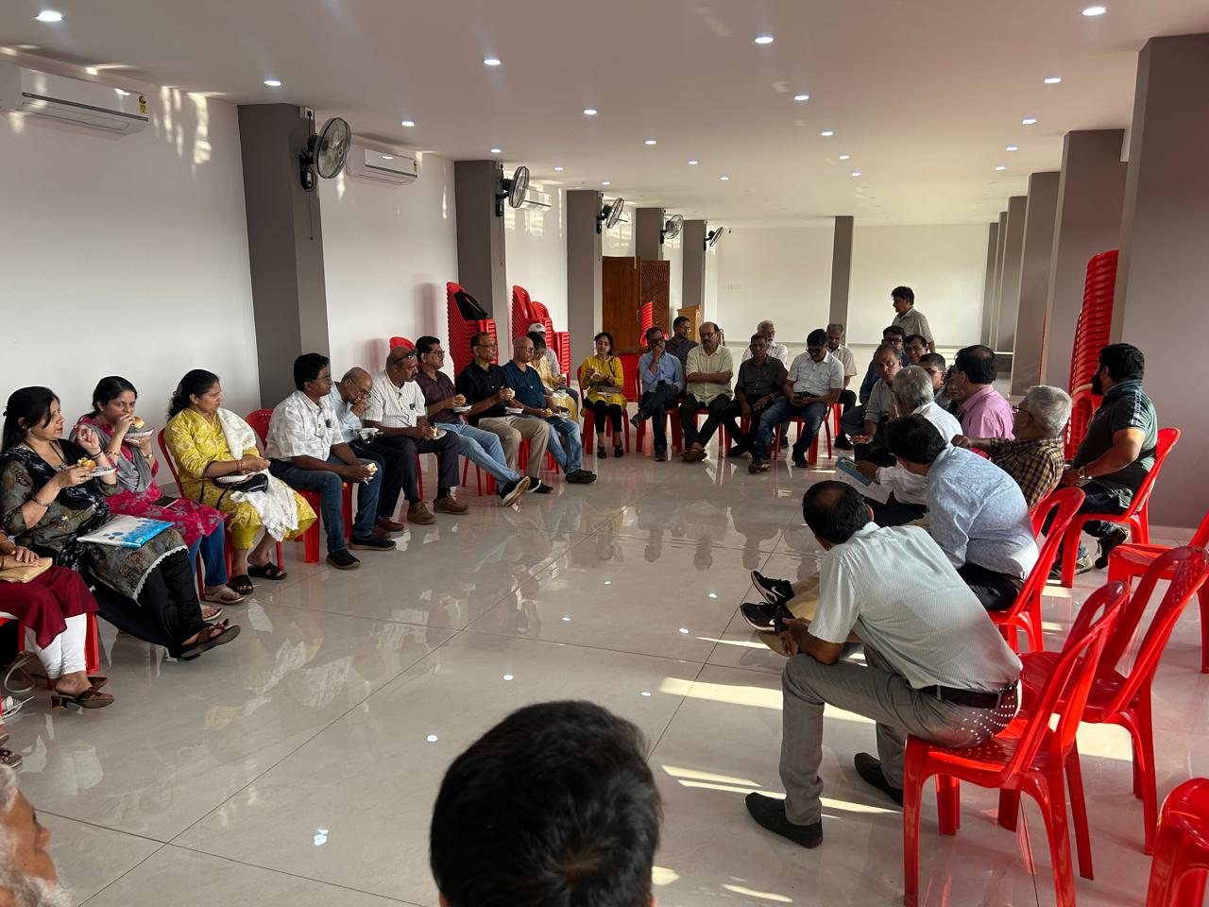
President was appointed in the Committee for District Conference and he participated in the meeting held for preparation of the conference

