Slide 1
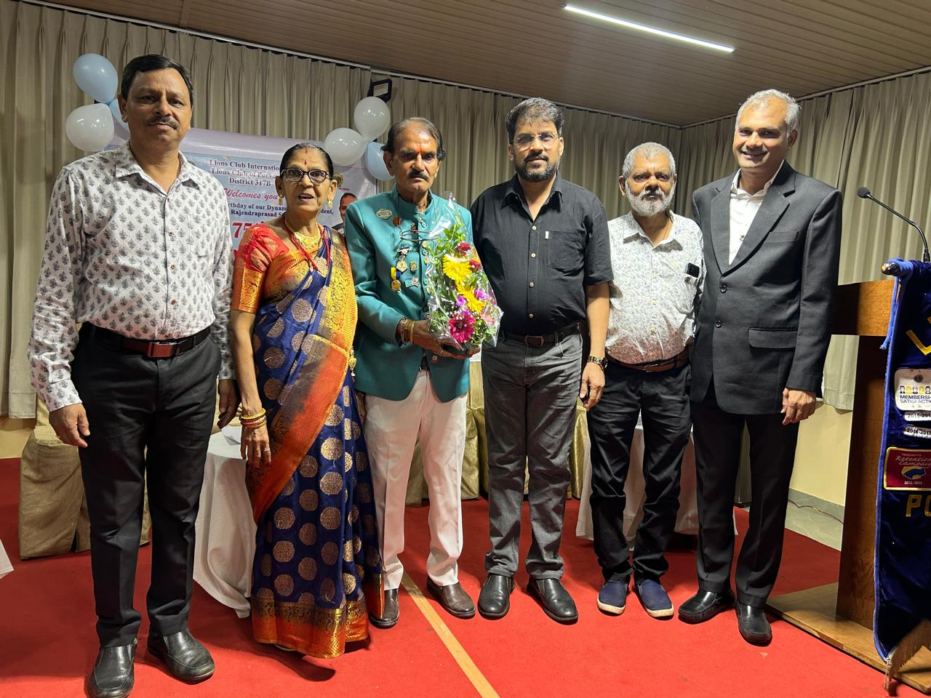
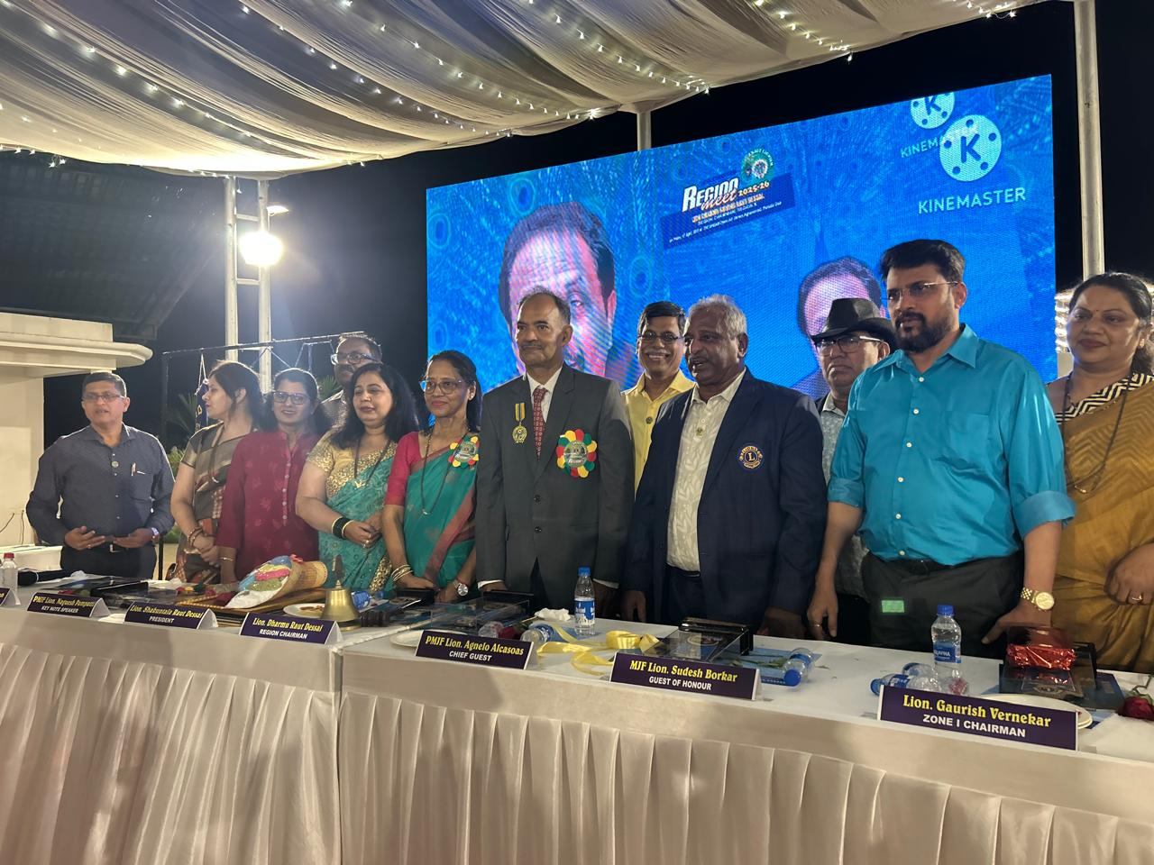
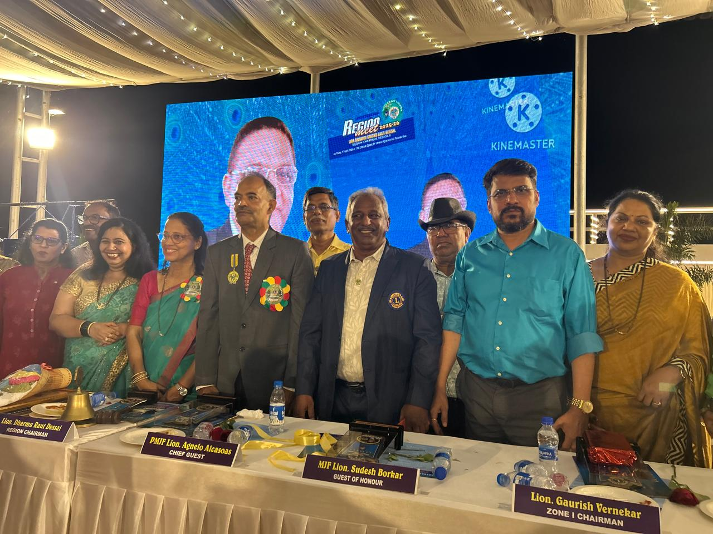
President attended 75th Birthday Celebration of President of Lions Club of Porvorim Ln Patel along with members on 11th April
President, Treasurer Ln Sharmila along with members Ln Prashant and Ln Jyotsna attended Region 2 Region Meet at Paroda, Qupem on 17th April

Slide 2
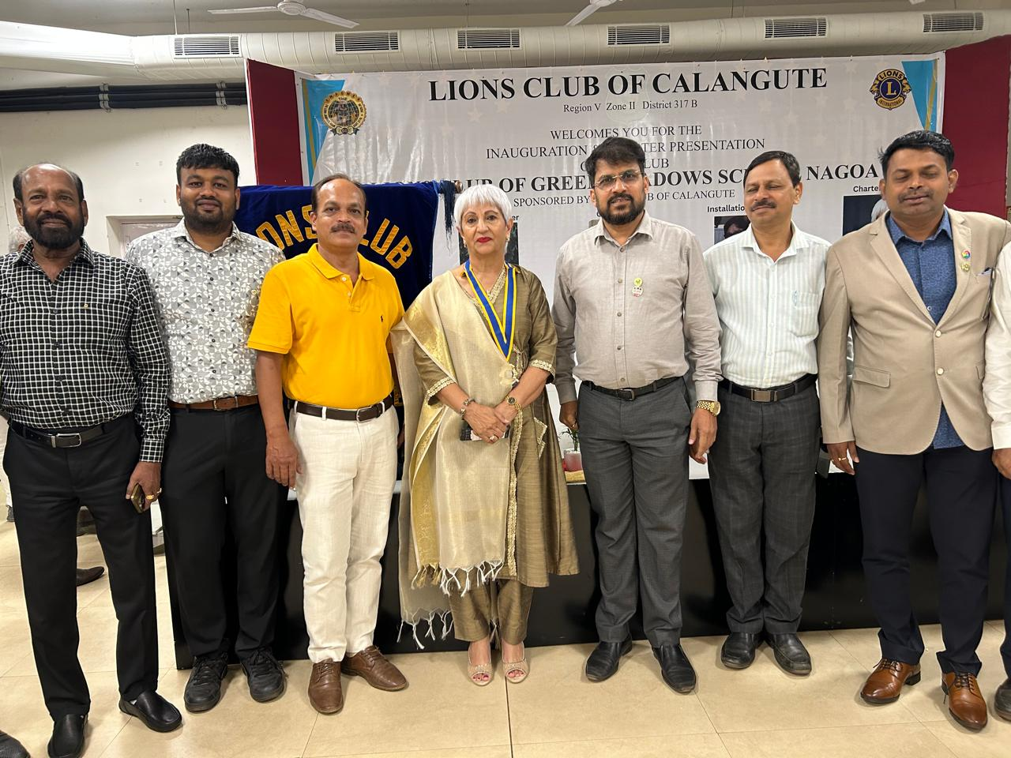
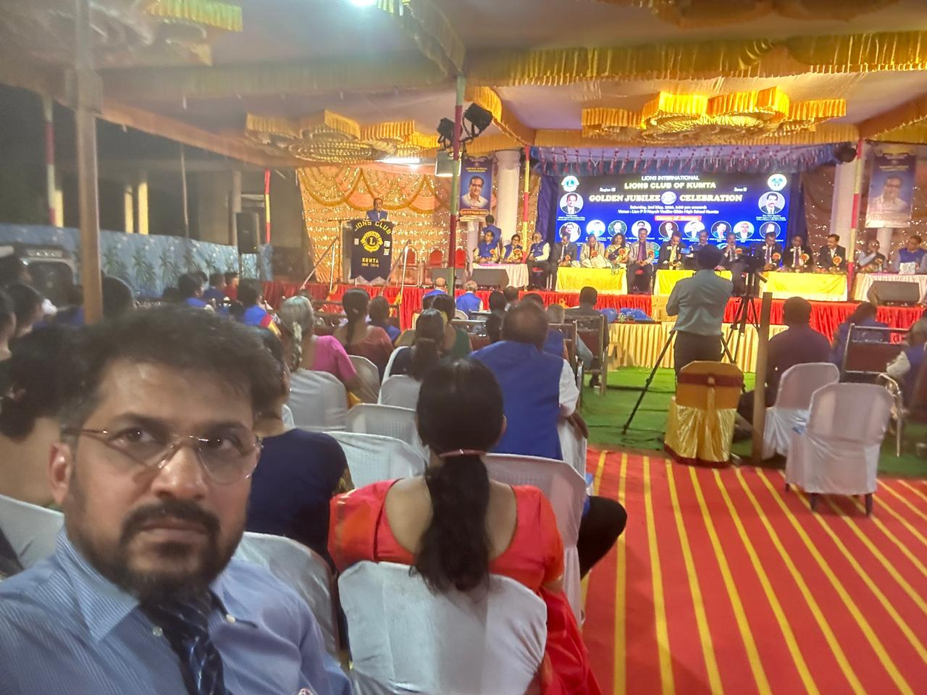
President and Members attended the Installation of Charter President of New Club – Lion Club of Green Meadows School, Nagao on 4th April
President attended Golden Jubilee Celebration of Lions Club of Kumta On 2nd May 2026

