Slide 1
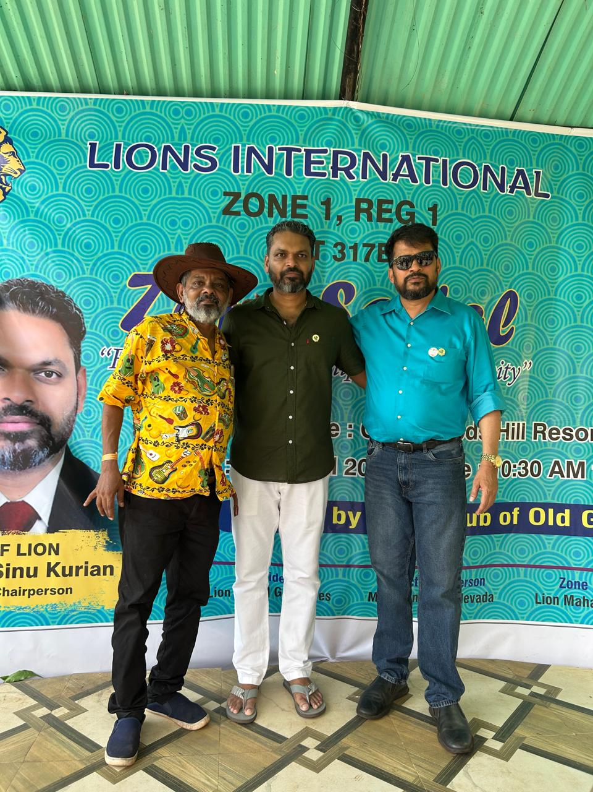
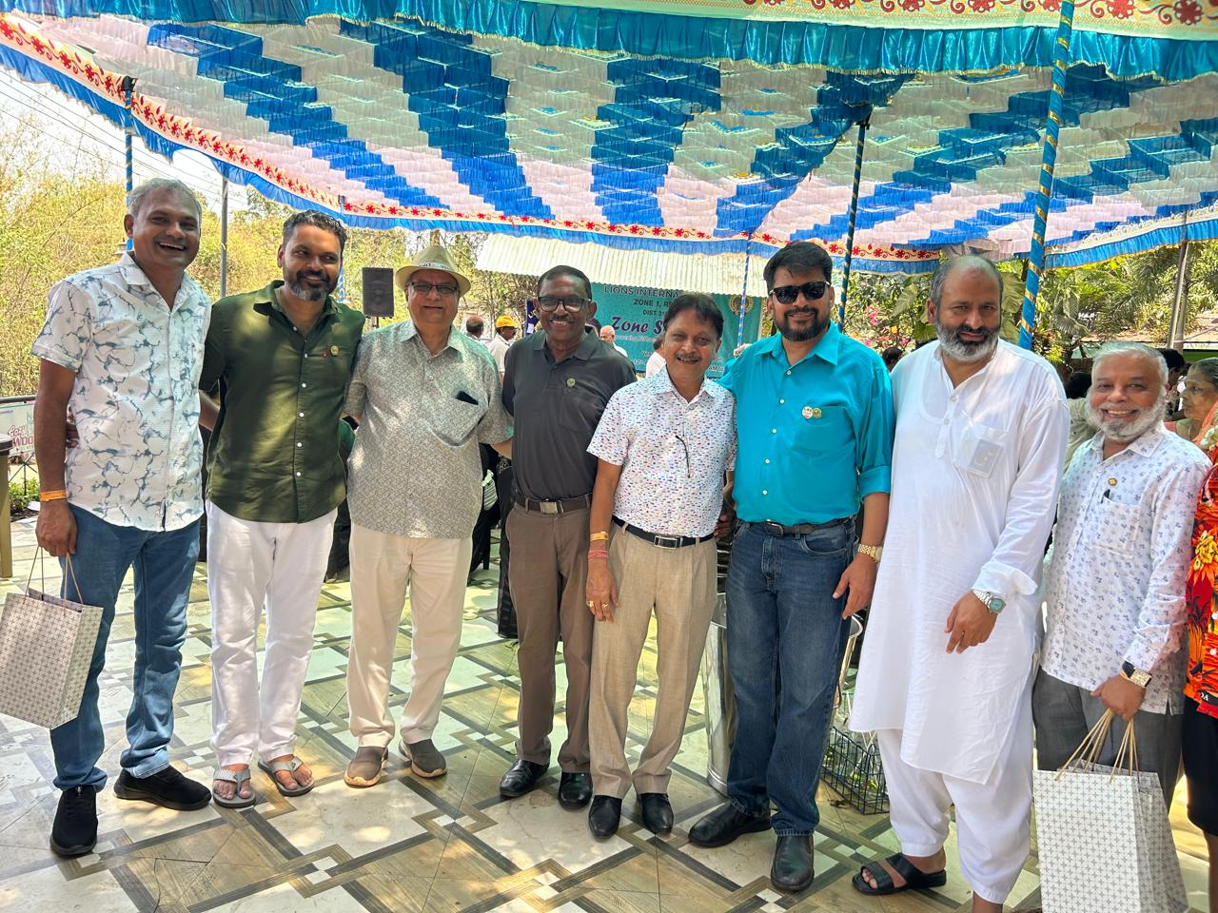
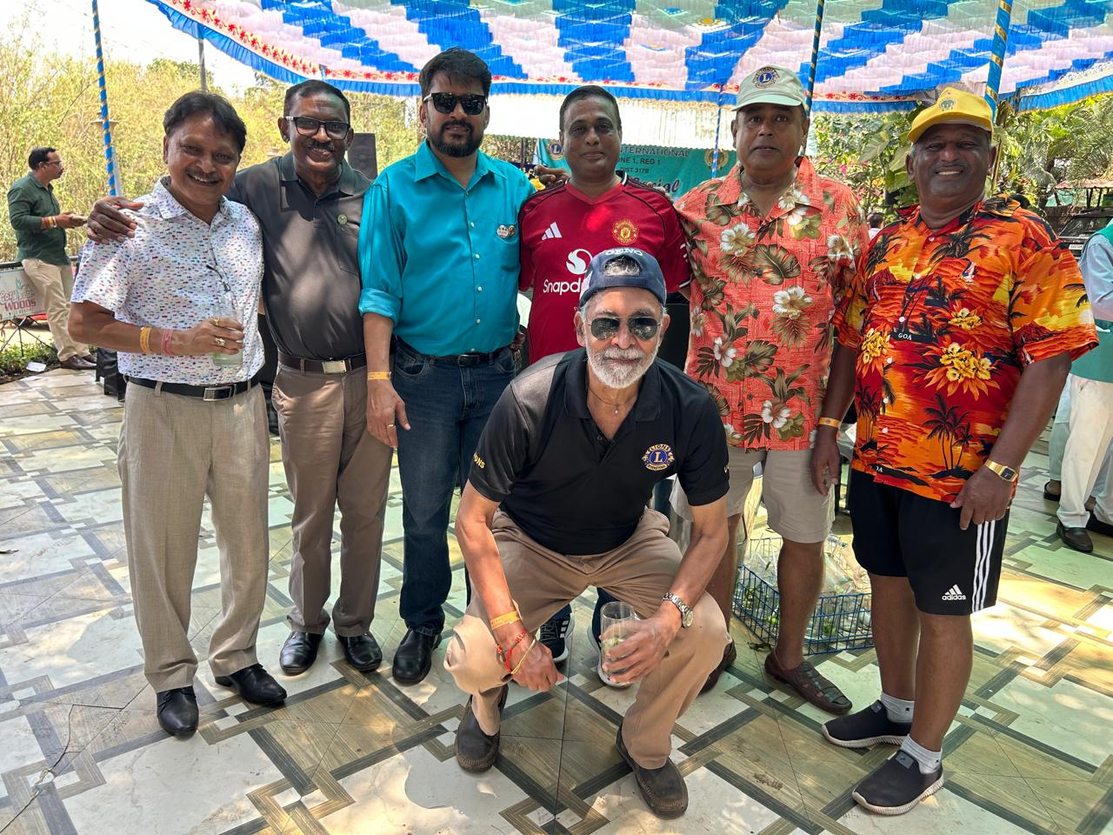
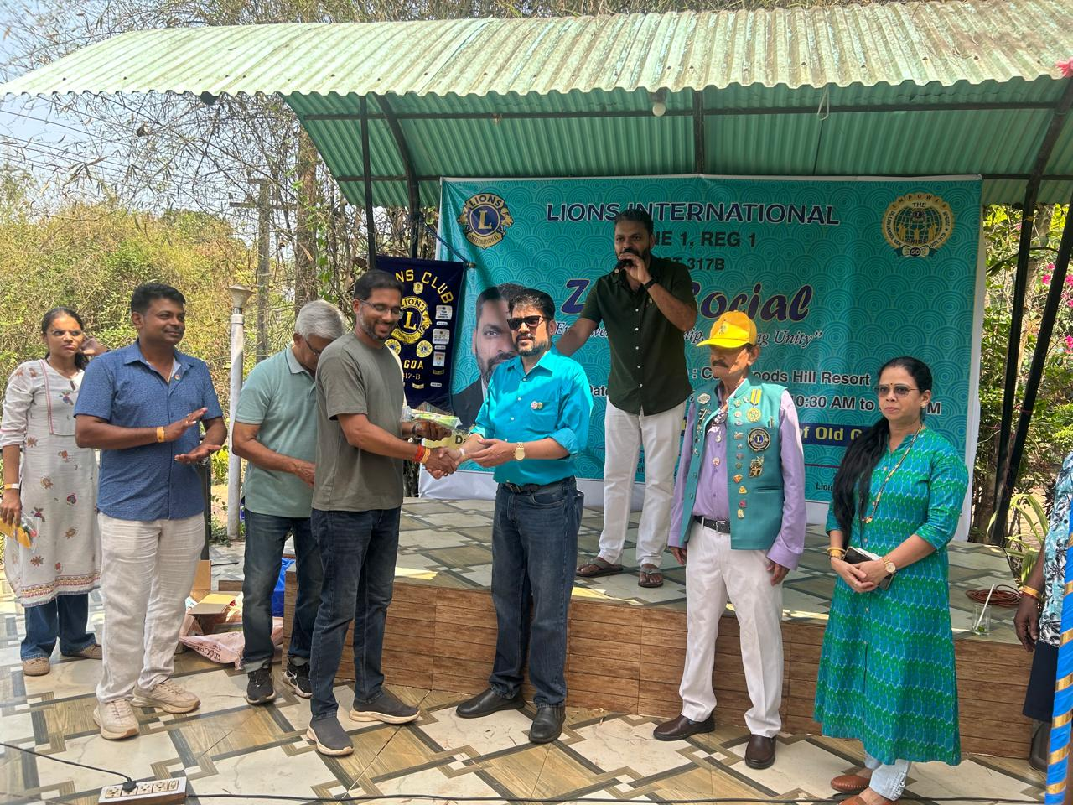
Attended Zone Social of Zone 1- Region 1 on 12th April at Cozy Woods Hill Resort, Carambolim, Old Goa
President Ln Deepak Tilve was awarded with special prize by Zone Chairman for wearing colour of celebratory colour of the zone

Slide 2
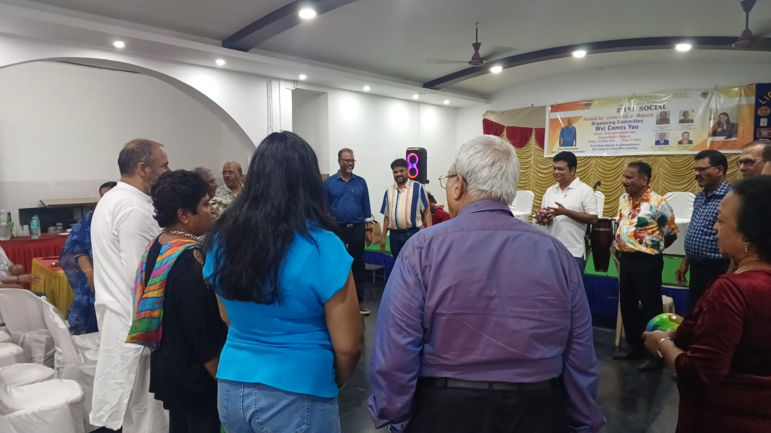
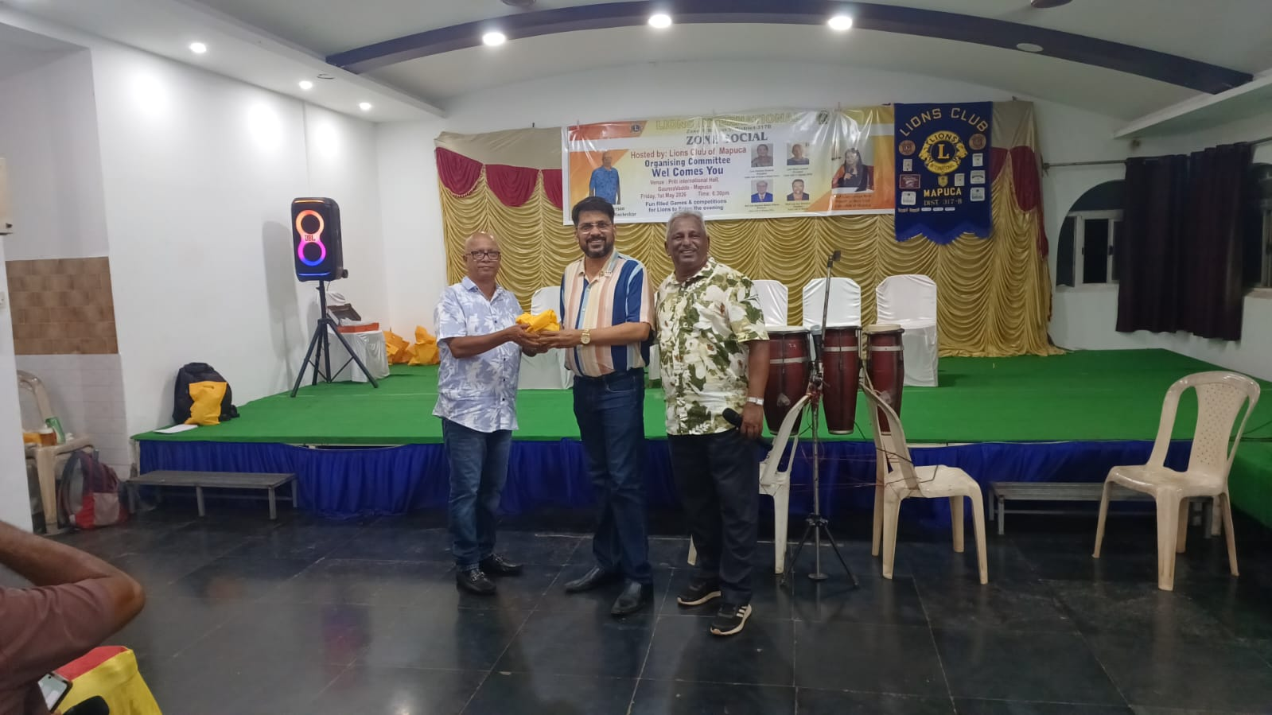
On 30th April, President attended Zone Social of Zone 5 at Preeti International and won the first place at Singing Competition

