Slide 1


Slide 2
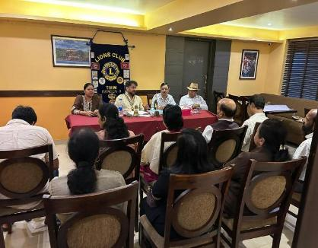
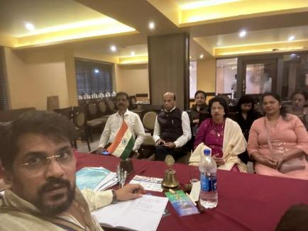
Conducted Special General Body Meeting on 14th April to plan and finalize the Projects for the Environment Week to be celebrated by the Club.
The meeting was well attended and was held at Lions Club of Tivim

Slide 3

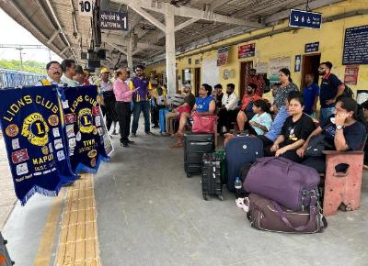
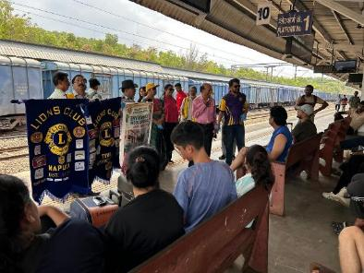
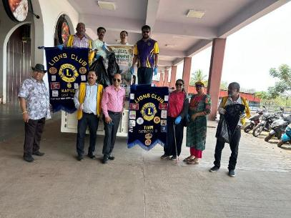
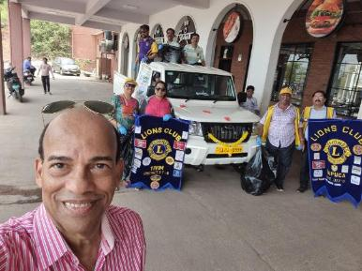

Slide 4
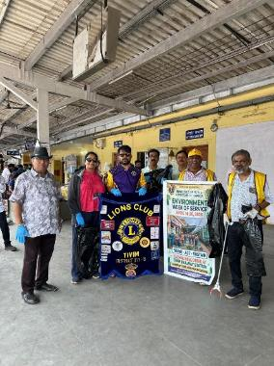
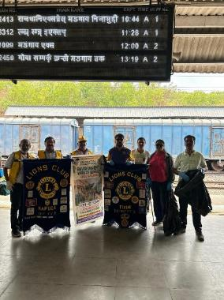
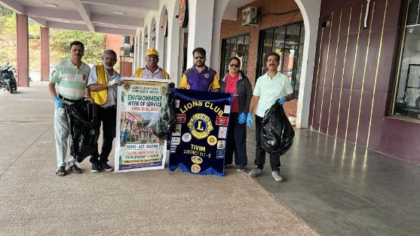
As a part of environment week, Lions Club of Tivim along with Lions Club of Mapusa organised Cleanliness Drive at the Thivim Railway Station at on 19th April 2026
Following areas of the Railway Station were cleaned by the members of both the Clubs 1. Platforms 2. Seating Benches 3. Railway Tracks and 4. Approach Roads and collected all the Plastic Waste and other waste.
Members of the Club Ln Dr Digamber Naik and President Ln Deepak Tilve also explained to the Passengers the “Need of Keeping Station Clean”
The waste collected was Transported and disposed in the proper fashion through local Panchayat

Slide 5

As a part of environment week, Lions Club of Tivim along with Lions Club of Mapusa organised E-waste Collection Drive.
Collection Point : Community Hall of Lions Club of Thivim
Duration : One week from 19th April to 26th April 2026
Purpose : Whoever either you or your neighbour, your friend has got E-Waste such as mobiles, broken mobiles, TV, fridge, washing machines, laptops, computer. Collection of E-waste is a project of District / International protecting “ENVIRONMENT”- Week of Service

Slide 6
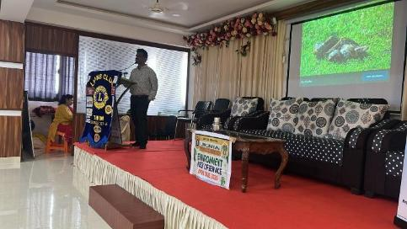
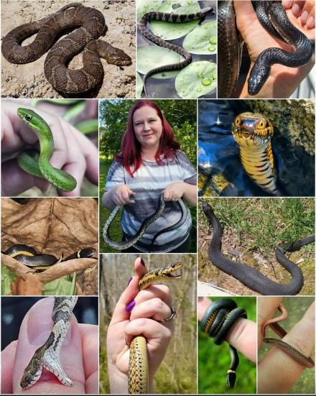
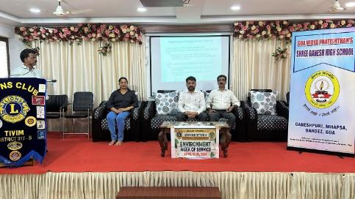

Slide 7
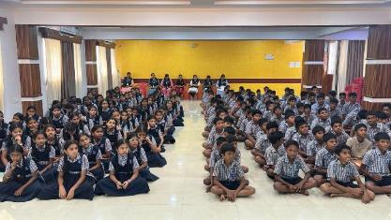
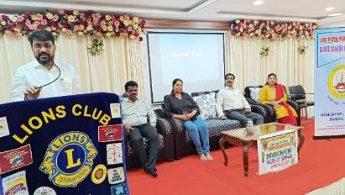
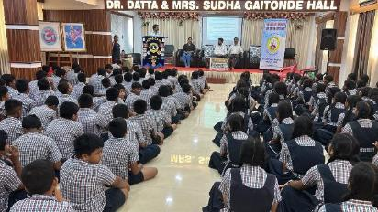
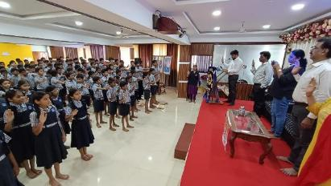
Talk on Segregation of Dry and Wet Waste was given by President Ln Deepak Tilve
Pledge was delivered to the students by President Ln Deepak Tilve to say “NO TO PLASTIC”
Date : 21st April
Venue : Ganesh Vidya Mandir Housing Board, Mapusa
Conducted Programme which provided information and knowledge about how to handle the Snakes if it comes in your house or if it comes in other residential areas
Faculty was Mr Sunil Korajkar who provided awareness about snakes and their benefits to eco-system
More than 200 students benefited from the Snake awareness talk

Slide 8
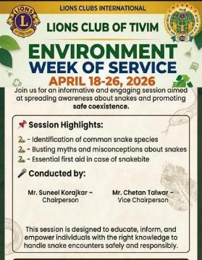
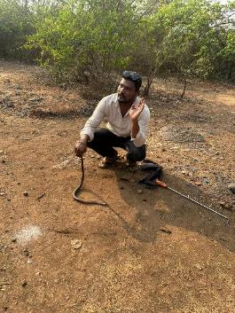
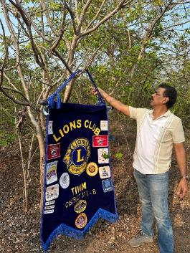
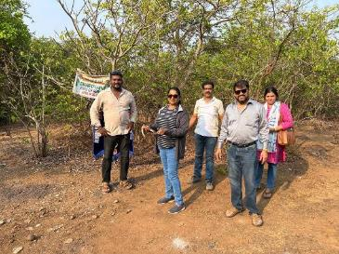
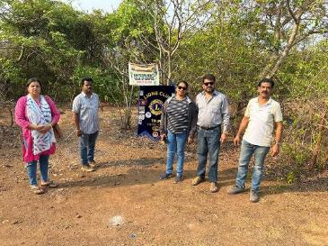
Date : 22nd April 2026
Location: Housing Board, Ganesh Puri, Mapusa
Conducted session on how to catch the snake and also release of Snake in the forest.
When you see a snake at your home or your office or anywhere, how to catch the Snake and how to handle them was demonstrated in workshop conducted by the professionals
Members went into the deep forest of Cuchelim and released five snakes
The release of snakes back into their natural habitat, often facilitated by wildlife rescuers, is crucial for maintaining ecological balance, biodiversity, and agricultural health. As both predators and prey, snakes serve as critical components in food webs, while their presence serves as an indicator of a healthy environment.

Slide 9
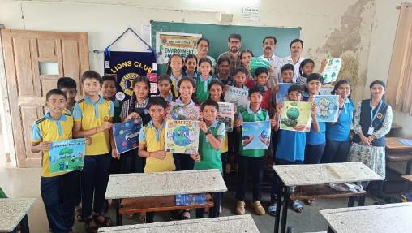
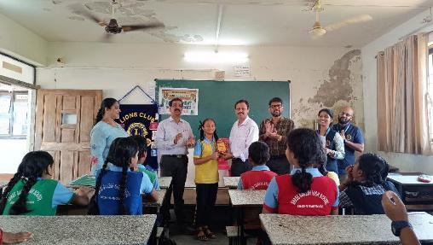
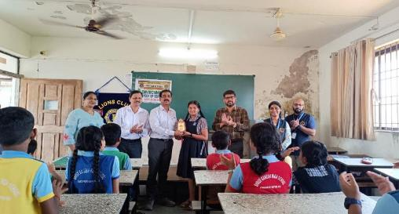
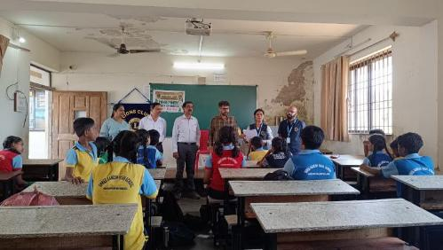

Slide 10
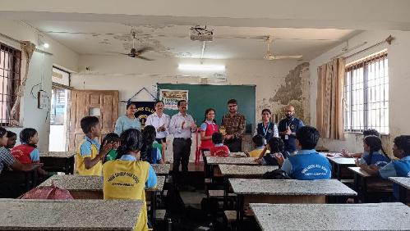
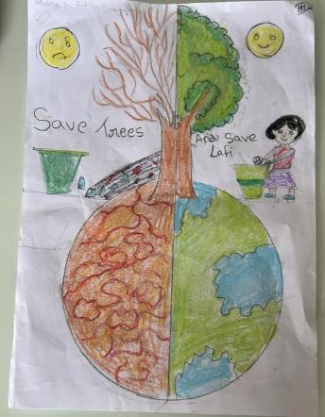
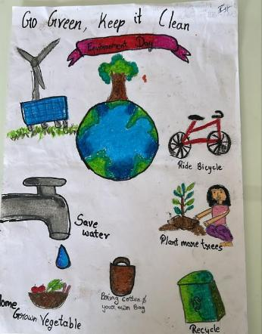
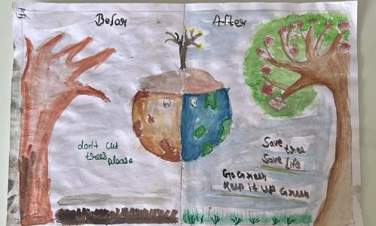
Date : 23rd April 2026
Conducted drawing competition for the students of Ganesh Vidyalaya School, Ganesh Puri, Mapusa
Competition is on the theme of the District and International
“GREEN FUTURE“ and prizes were distributed to the winners
Posters - Save Earth / Save Water / Save Planet / Say NO to Plastic / Use Bicycles / Use Electronic Vehicles were displayed in the school premises

Slide 11
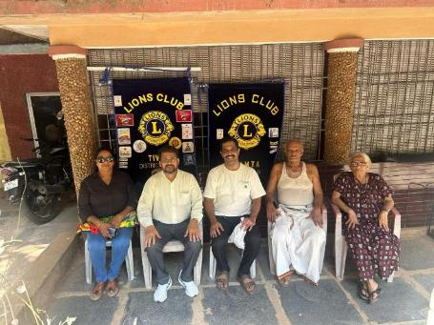
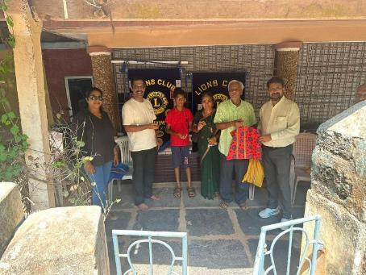
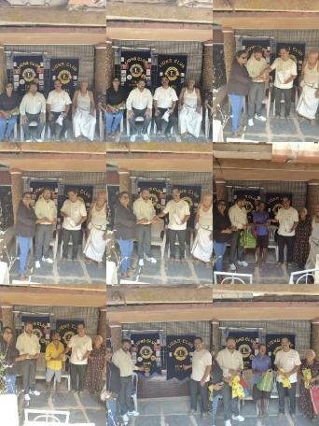
Under Twinning Programme, on 3rd May, Lions Club of Tivim and Lions Club of Kumta distributed Cotton bags and seed balls at Kumta on the occasion of Environment Day

