Slide 1
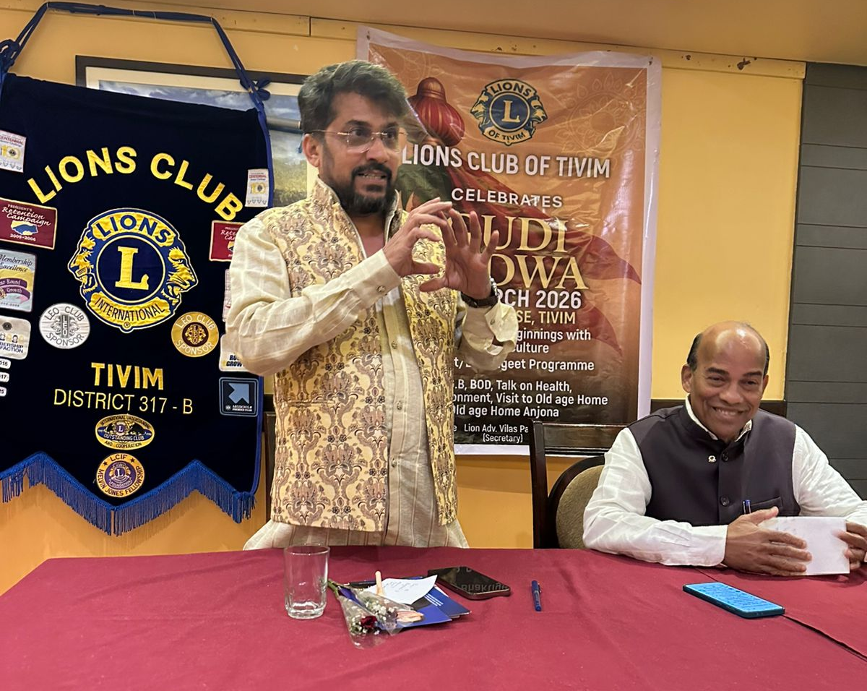
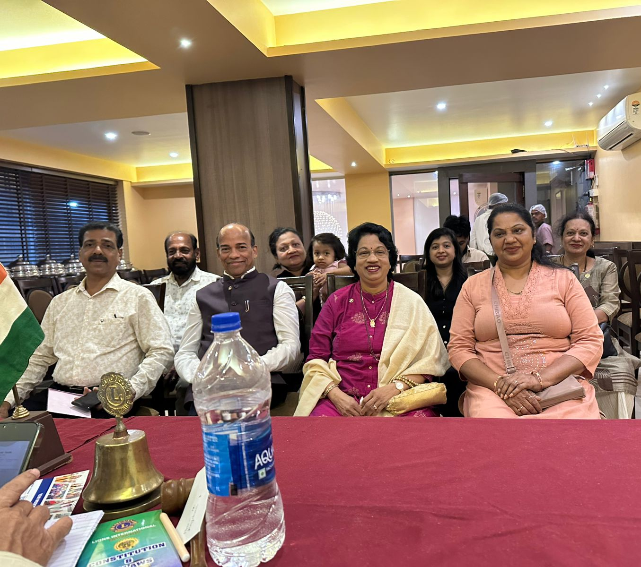
NEW YEAR “GUDI PADWA” CELEBRATION
Date : 22nd March 2026
As part of New Year “Gudi Padwa” celebration at Club Premises
President Ln Deepak Tilve spoke about Importance of Gudi Padwa and its celebration in Hindu Calendar and it importance to organization
Bhavgeet and Bhaktigeet was organized and members actively participated in the singing of Marathi Songs.

