Slide 1
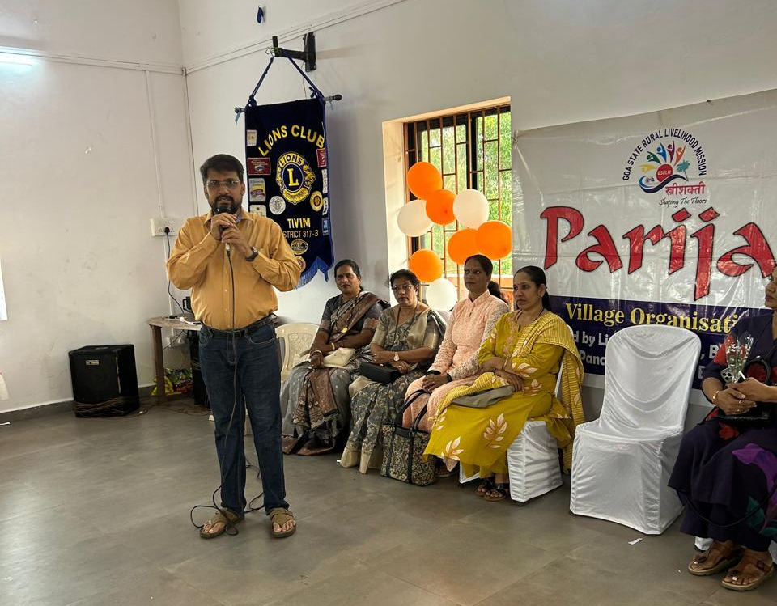
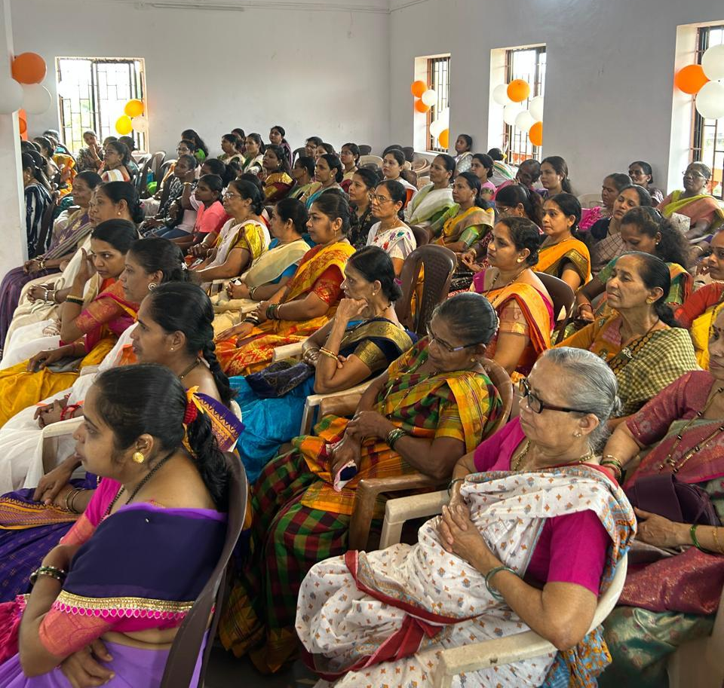
WOMEN EMPOWERMENT DAY CELEBRATION
Date : 22nd March 2026
PARIJAT – Women Empowerment Day was celebrated in association with Guirim Village Panchayat at Guirim Panchayat Hall
The programme was based on theme of District Governor and included Talent Hunt for women villagers and also presentation of “Women Achiever Award”
Programme Co-Ordinator was Lion Deepak Naik
Programme also included Singing Competition for Women and Fancy Dress Competition for Women
President Ln Deepak Tilve delivered a talk on rights of women in the property and rights under section 125. an article 29 of Portuguese Law

