Slide 1
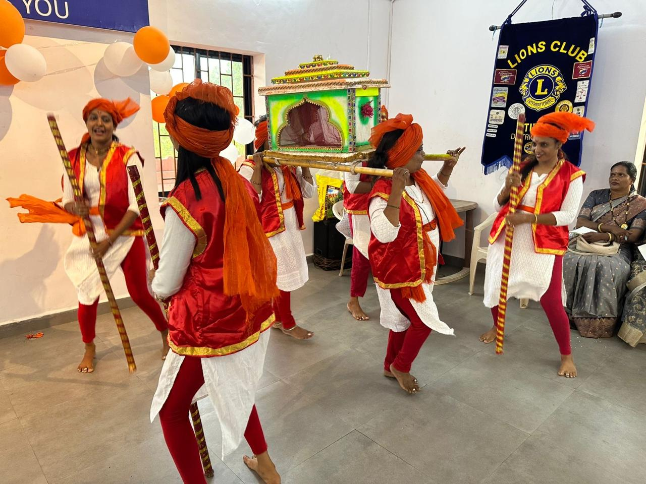
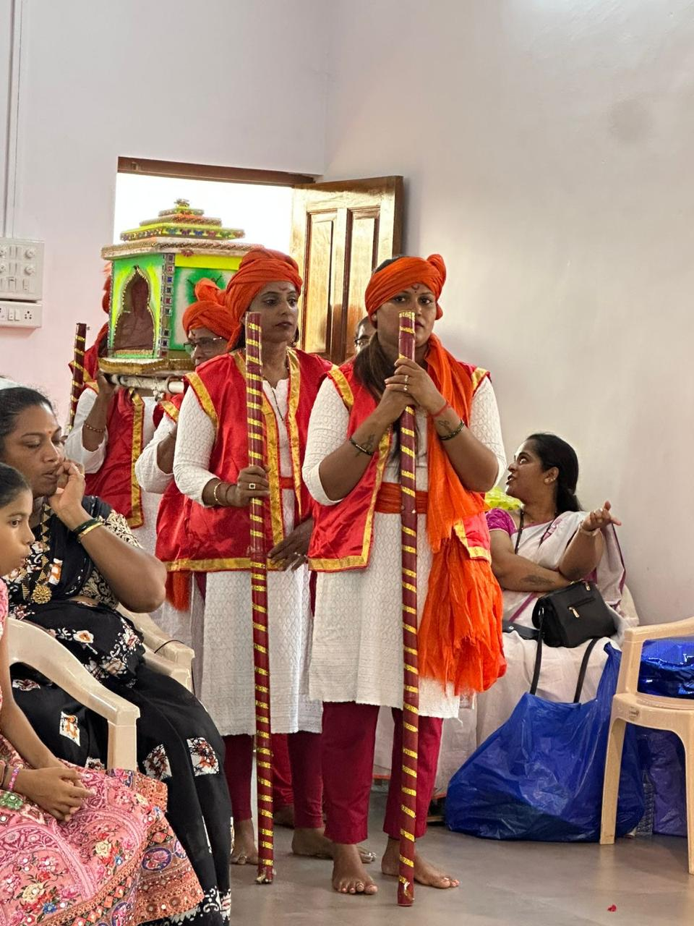
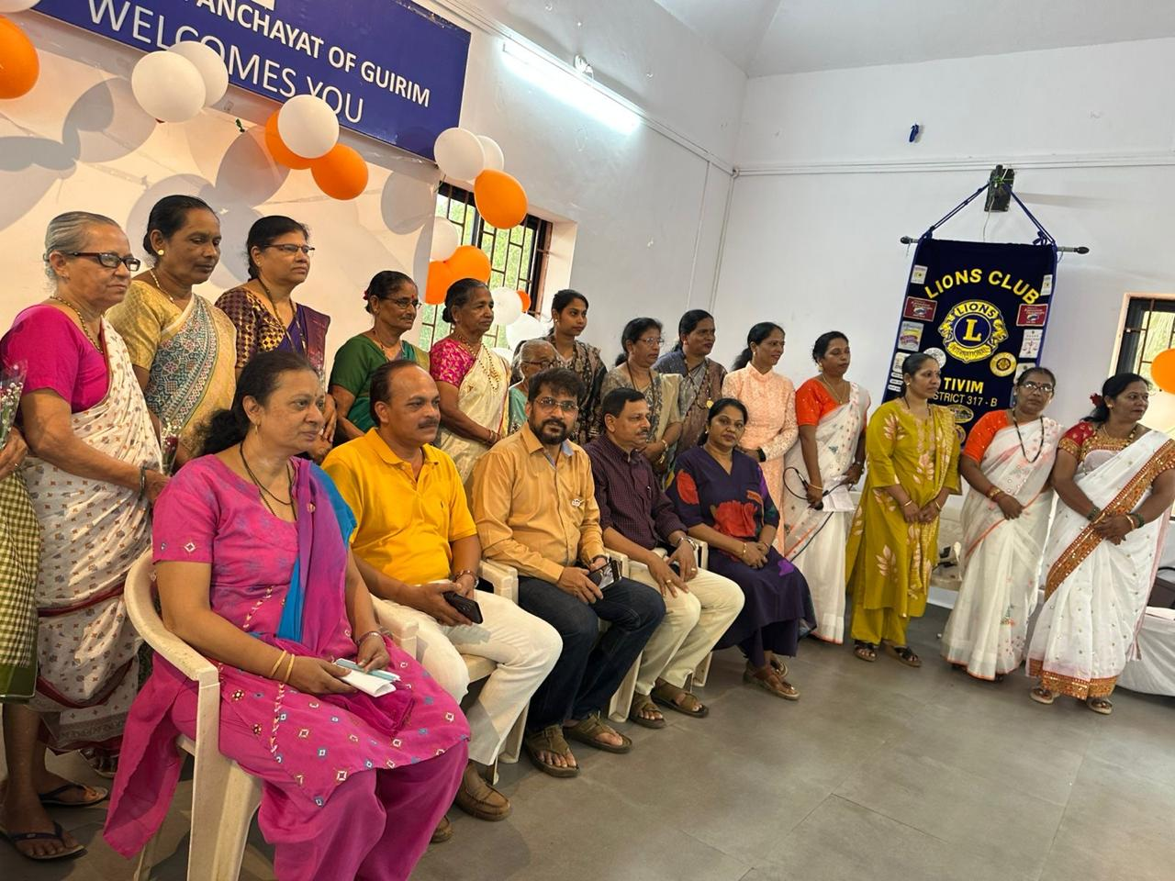
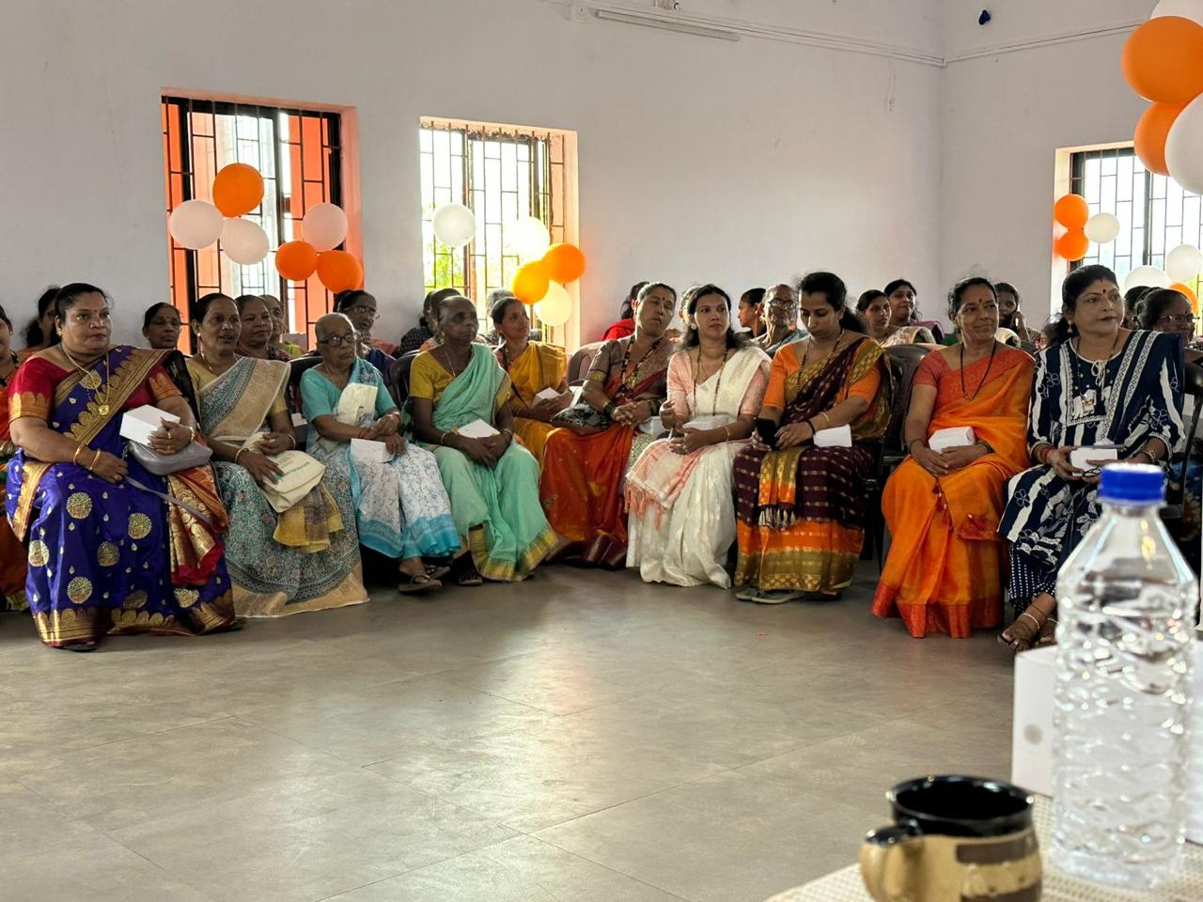
TRADITIONAL GOAN DANCE COMPETITION
Date : 17th March 2026
Was organized in association with Guirim Village Panchayat at Guirim Panchayat Hall
Local Villagers participated in the Traditional Goan Dance Competition displaying their talent and promoting Goan Culture

