Slide 1
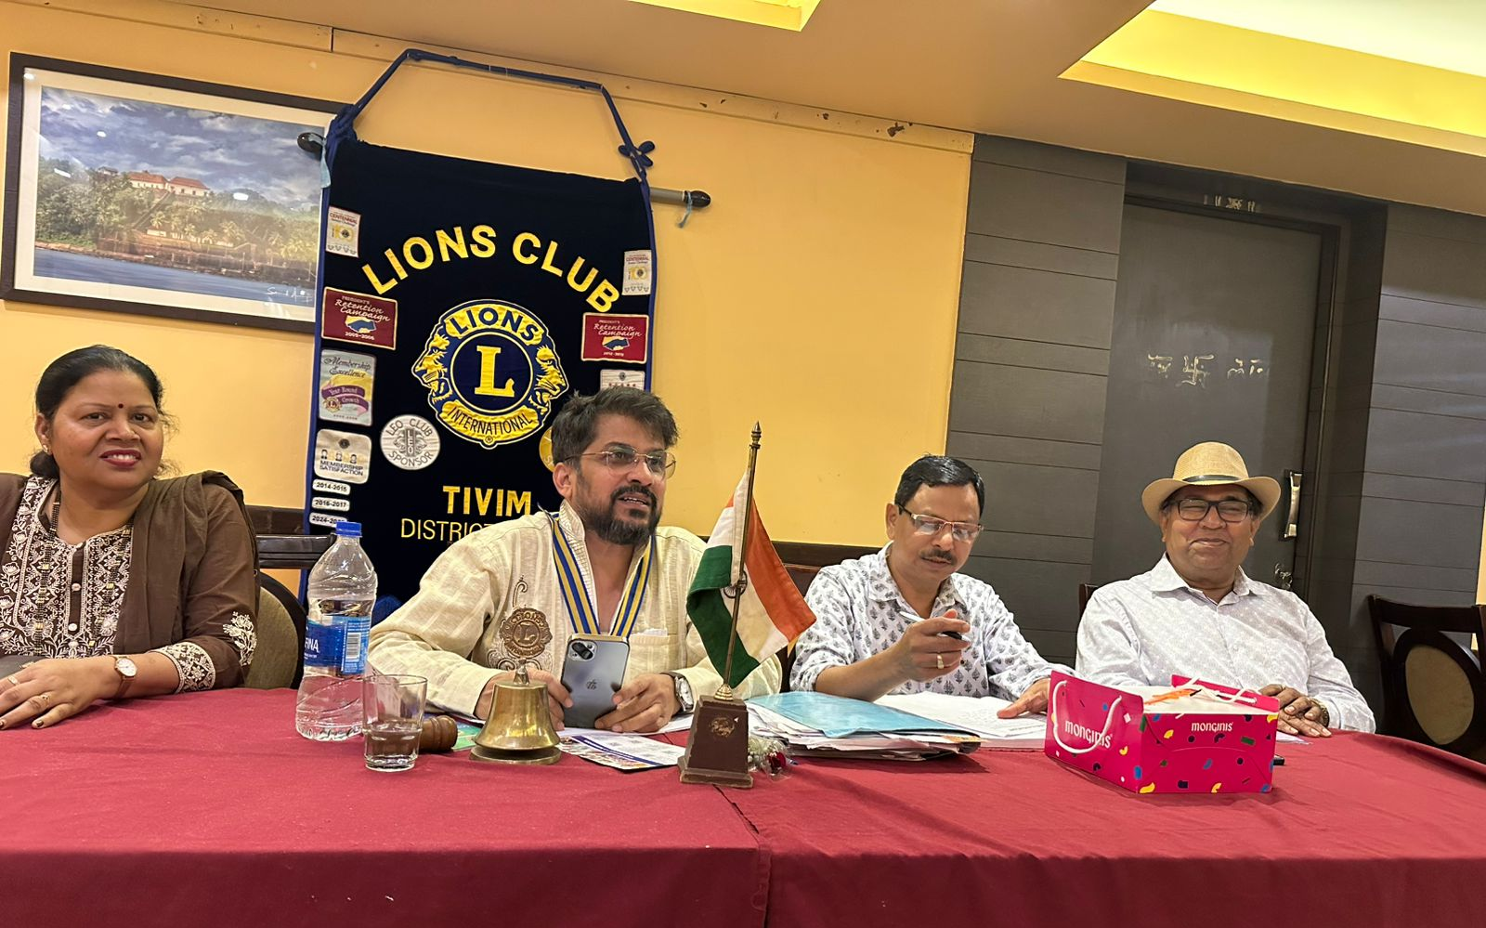
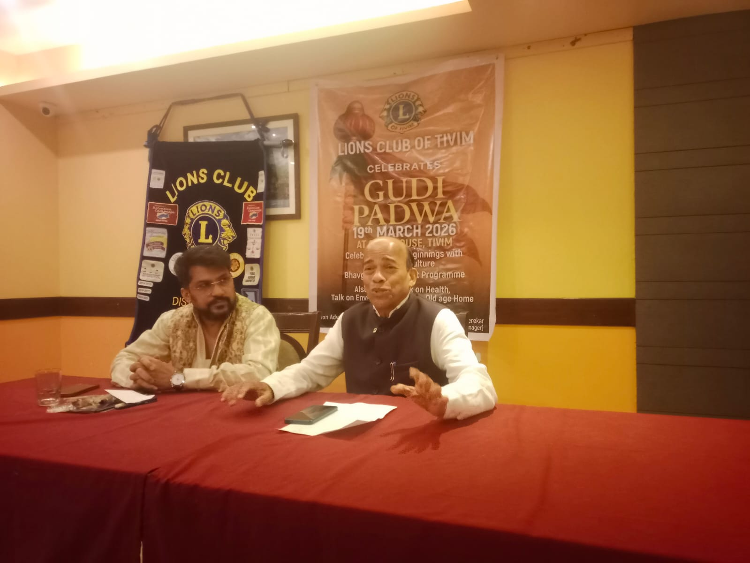
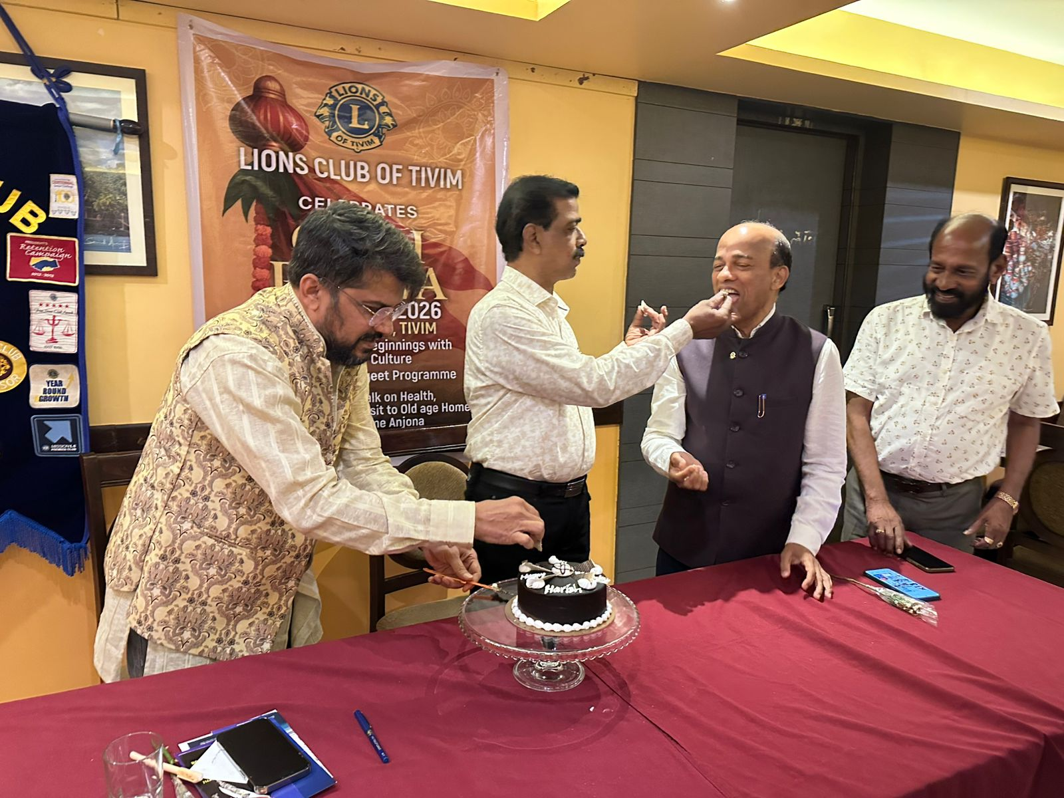
BOD AND GENERAL BODY MEETING
Date : 22nd March 2026
BOD and General Meetings was conducted at the Club Premises
General Body Meeting was followed by talk by Ln Dr Digamber Naik. The topic was “Maintaining Good Health, Controlling Diabetics and Overcoming Stress”
Birthday of Ln Harish Nasnodkar was also celebrated after conclusion on the meeting

