Slide 1
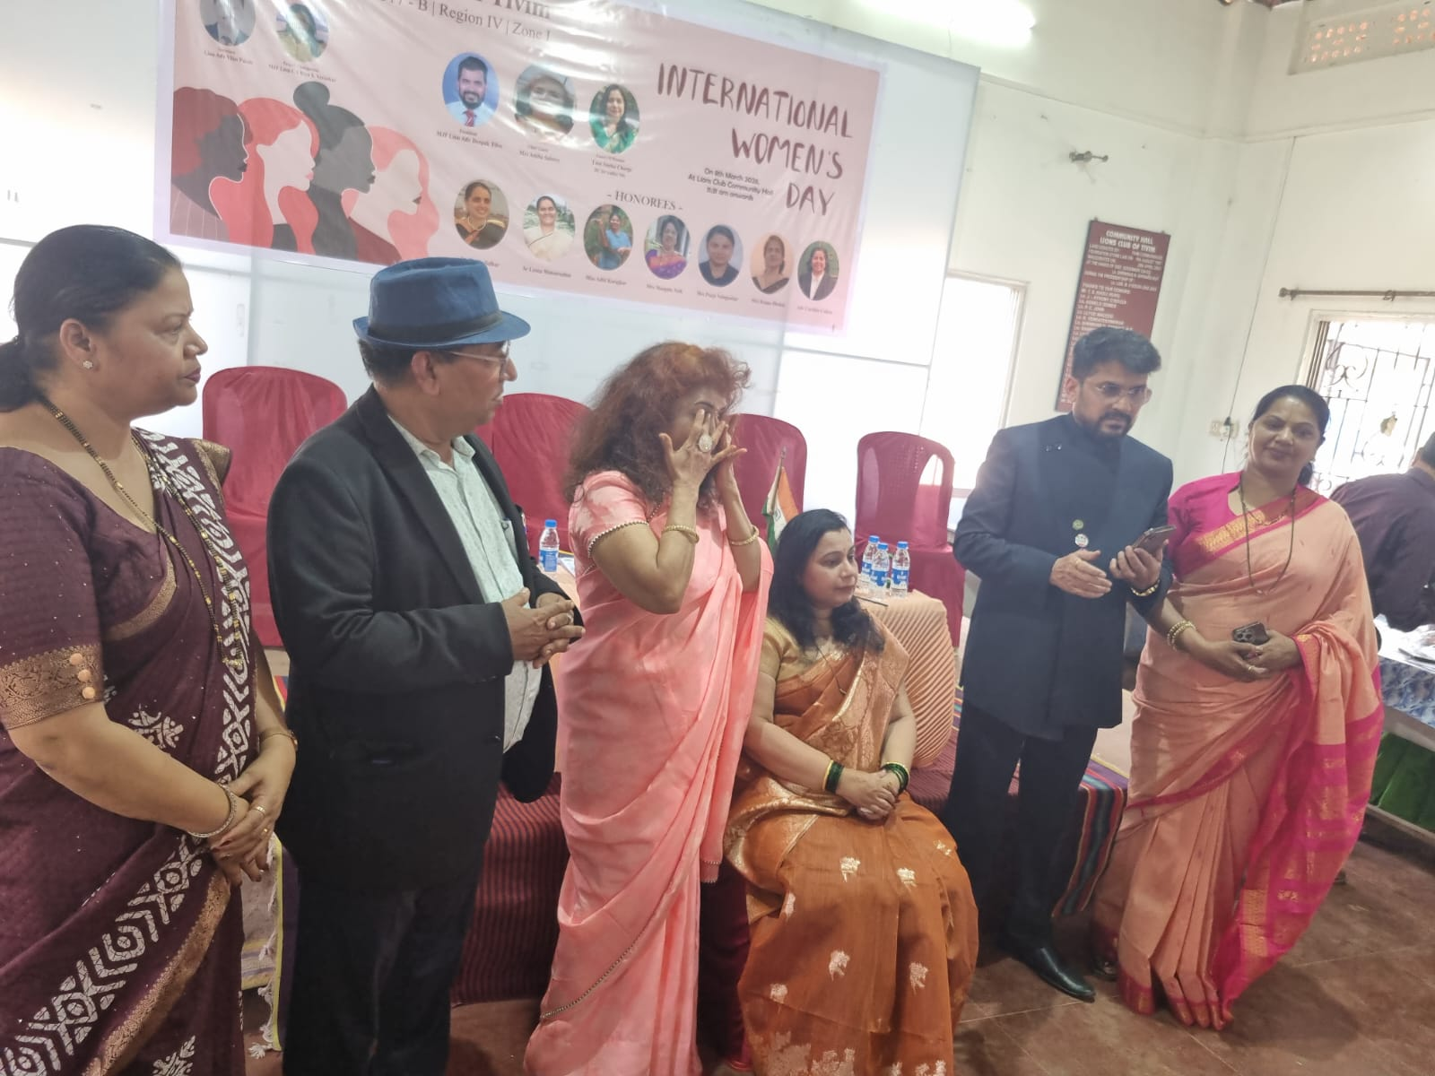
LADIES NIGHT CELEBRATION
Date : 8th March 2026
Venue-Lions Club House, Tivim
On the occasion of International Women Day, Ladies Night was celebrated
Ladies members of the Club and members of the Club participated in the event
DC for Ladies Night Ln Sneha Chorge was felicitated on this occasion

