Slide 1
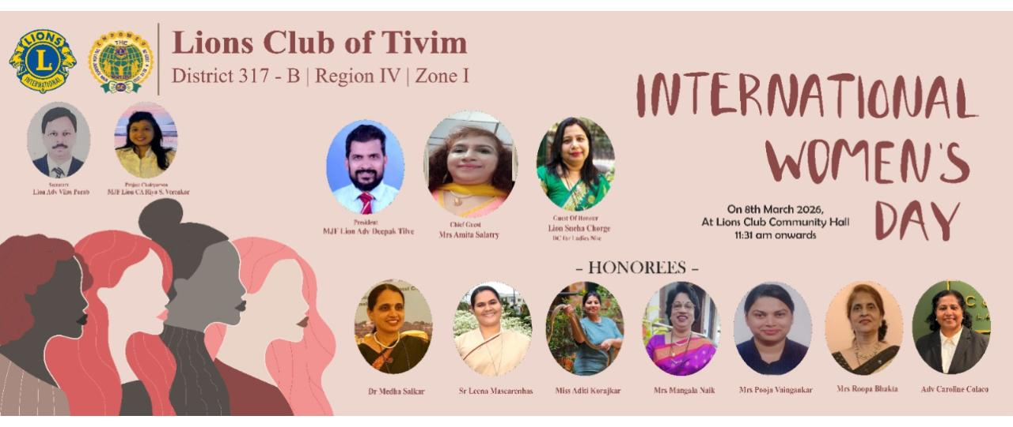

INTERNATIONAL WOMEN DAY CELEBRATION
Date : 8th March 2026
International Women Day was celebrated at Lions Club House, Tivim
Chief Guest for the function was Mrs Amita Nayak Salatry and Guest of Honour was Ln Sneha Chorge
Seven Ladies were felicitated on this occasion for their contribution to the society and being role models to many young ladies.
All these ladies were from Tivim and surrounding areas
2 BOD meetings and 1 GB meeting were conducted to plan this event

Slide 2
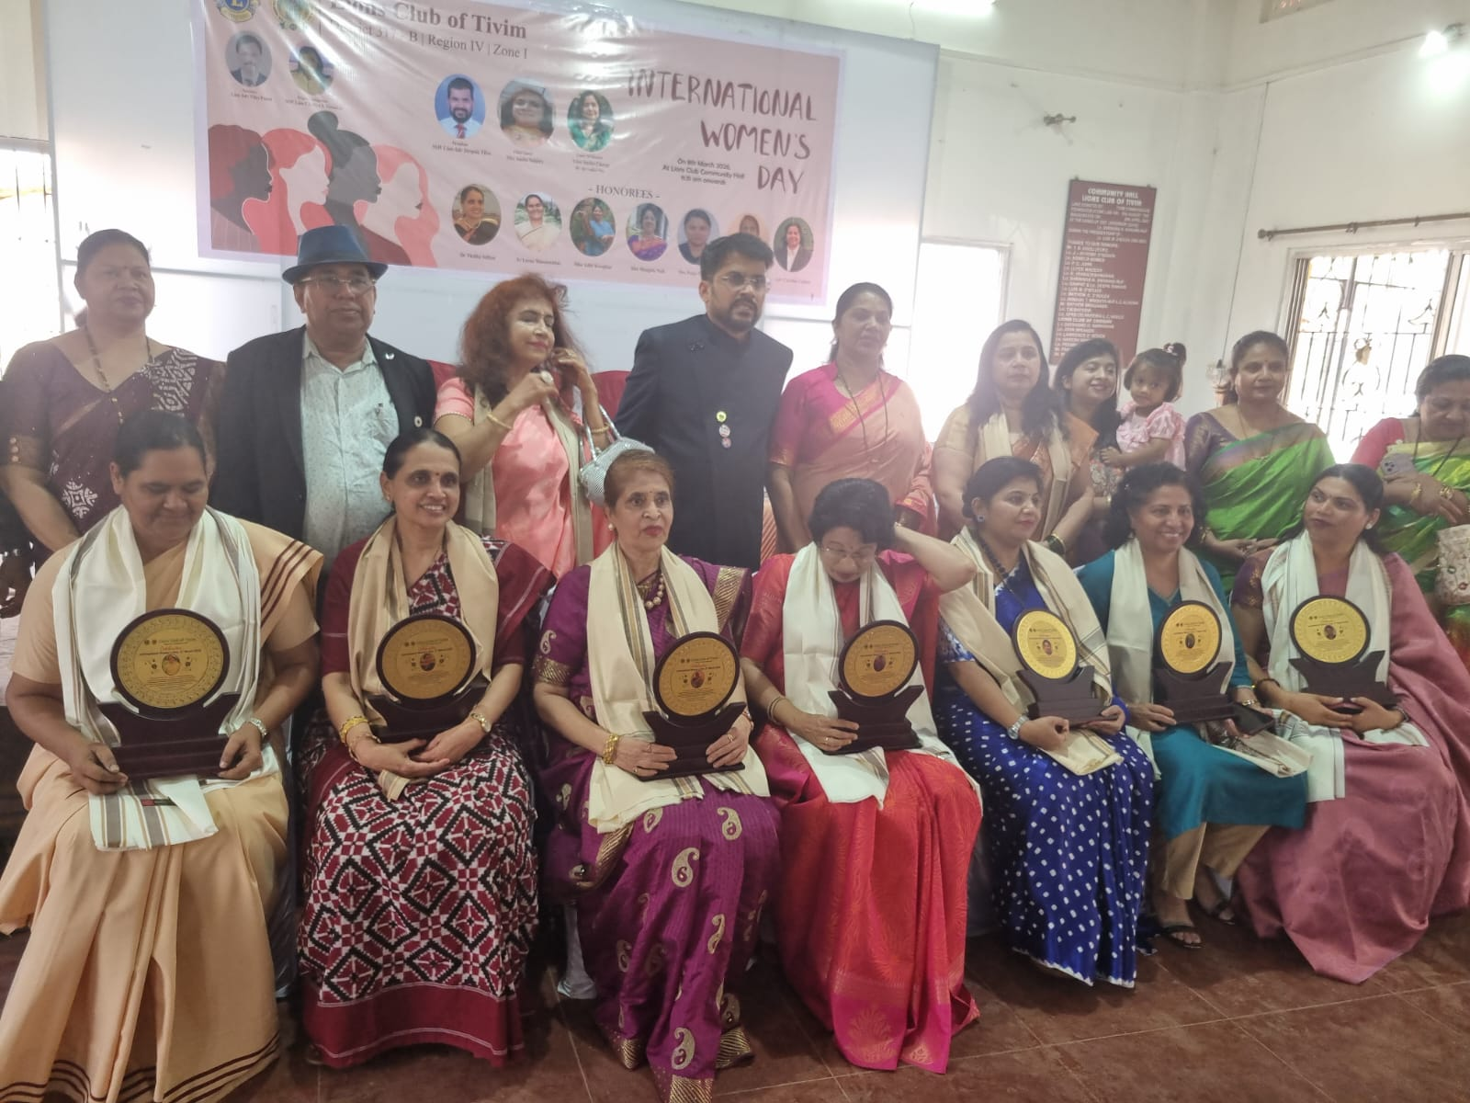
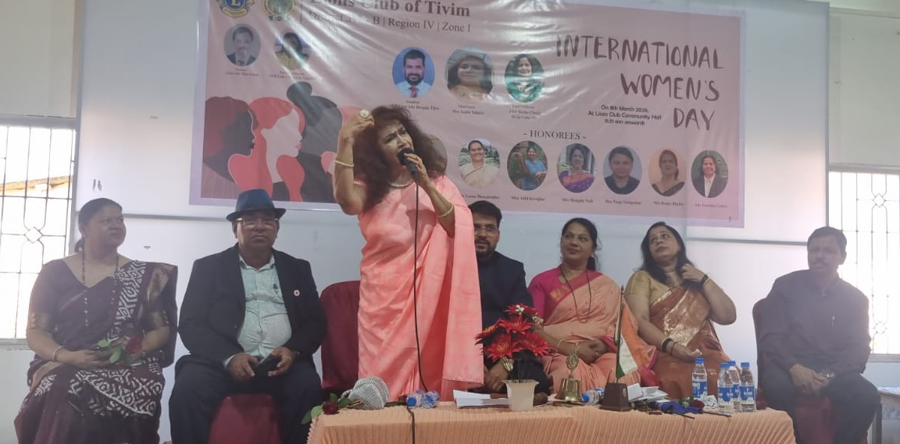
INTERNATIONAL WOMEN DAY CELEBRATION
Chief Guest Mrs Amita Nayak Salatry speaking on the occasion of International Women Day
Group Photo of the Ladies felicitated by the Club on the occasion of “International Women Day” by gibing them Shawl, Coconut, Memento and Flower Pot

Slide 3
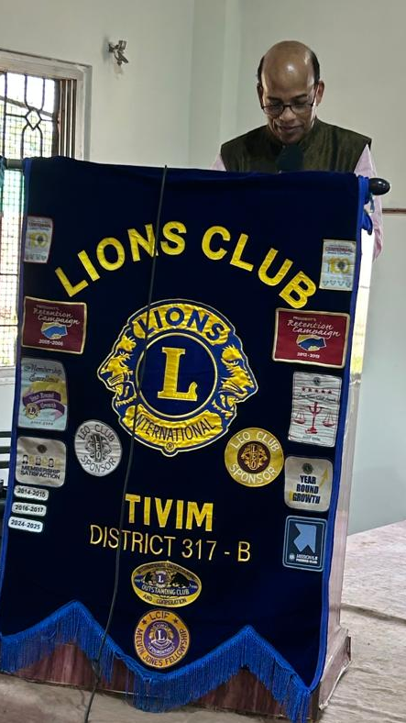
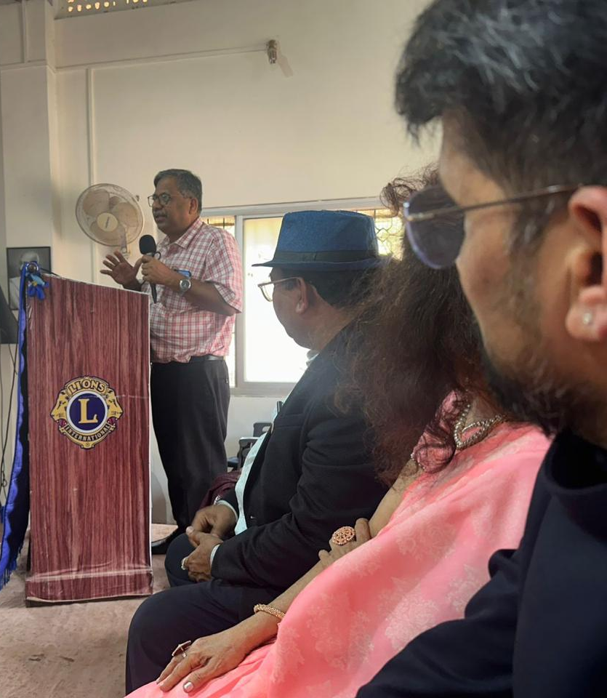
INTERNATIONAL WOMEN DAY CELEBRATION
Famous Cardologist Dr Digamber Naik delivered a talk on Healthy Lifestyle of Women
Renowned Oncologist Dr Shekhar Salkar delivered a talk on “Prevention and Detection of Cancer” (Cancer Awareness Talk) on this occasion

Slide 4
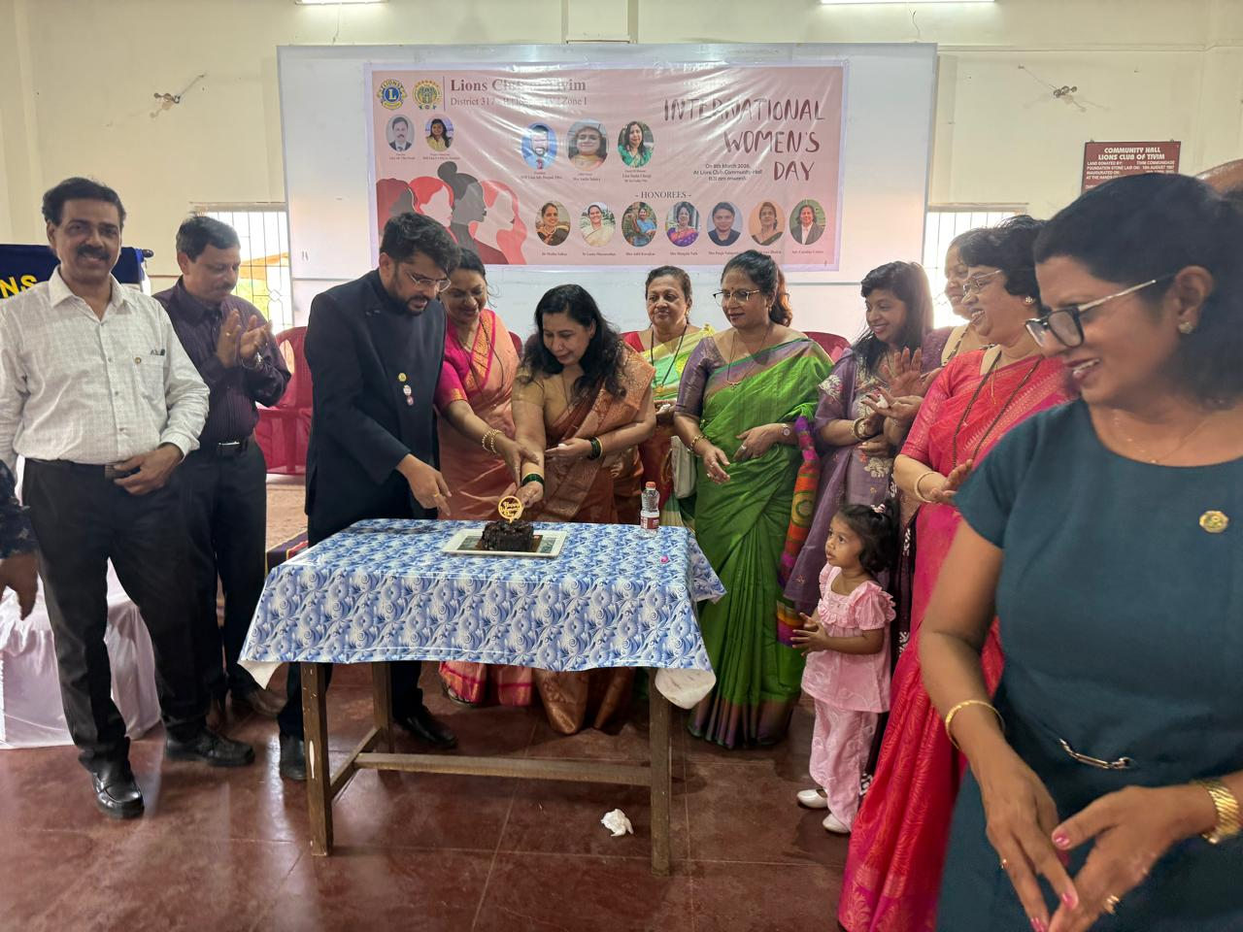
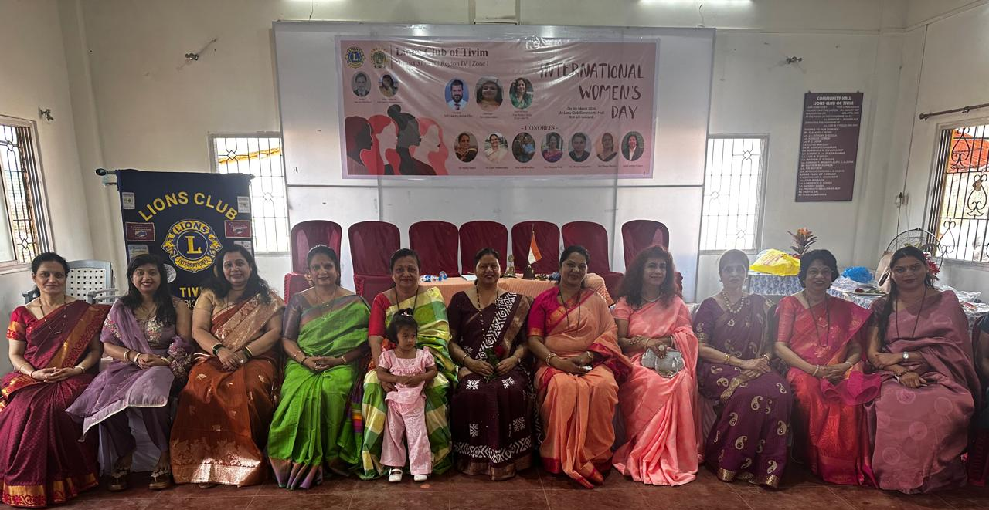
INTERNATIONAL WOMEN DAY CELEBRATION
Club also felicitated Lady Members of the Club on the occasion of “International Women Day”
Guest of Honour Ln Sneha Chorge cutting cake to celebrate “International Women Day”

