Slide 1
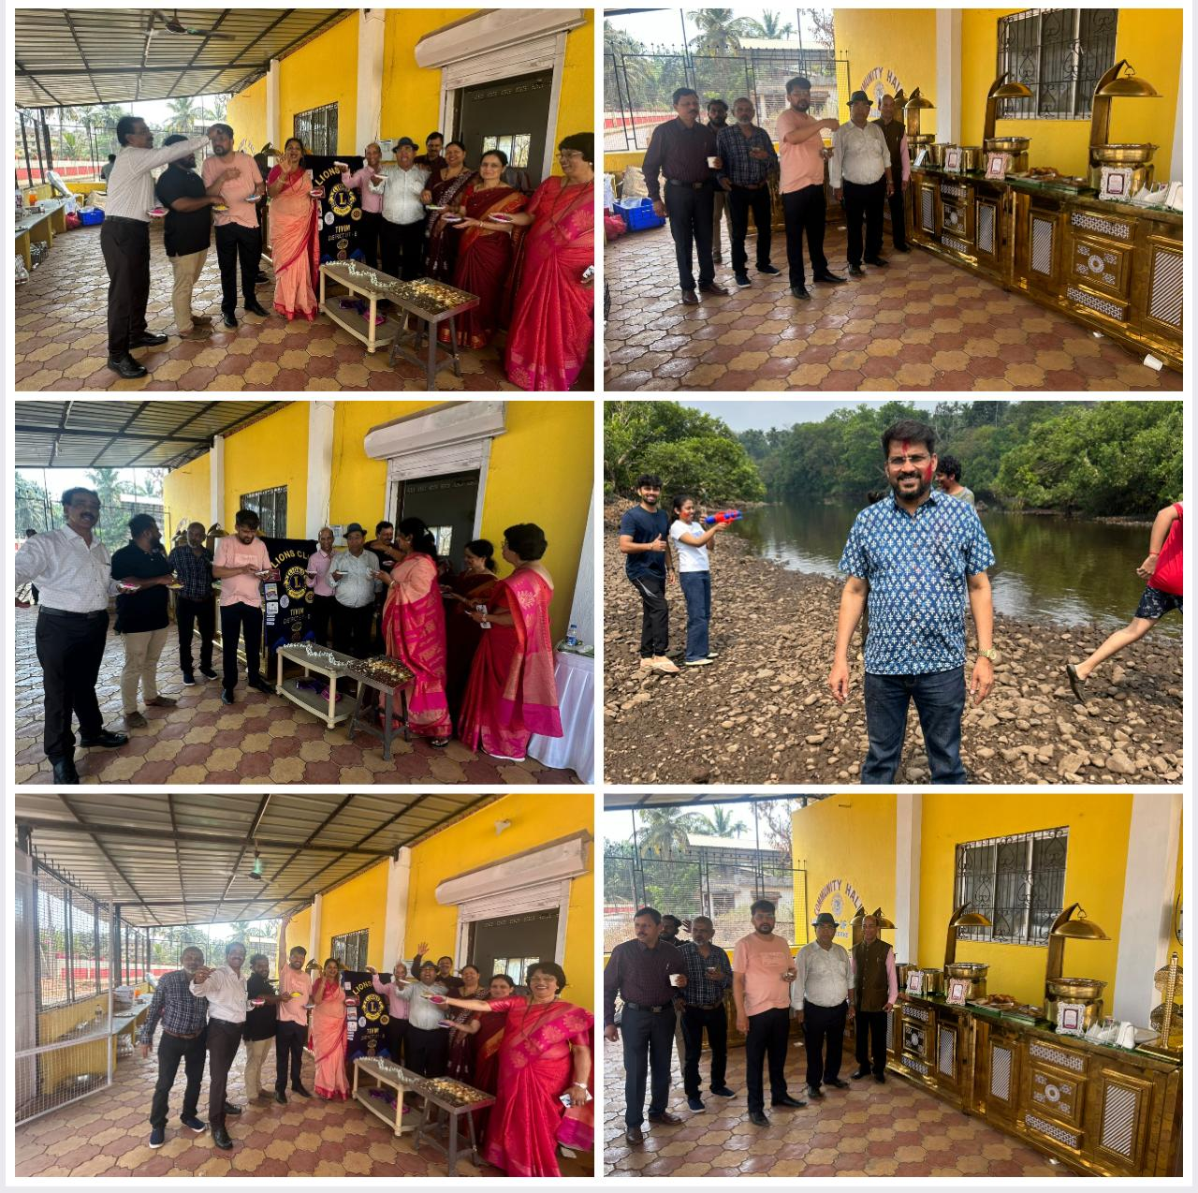
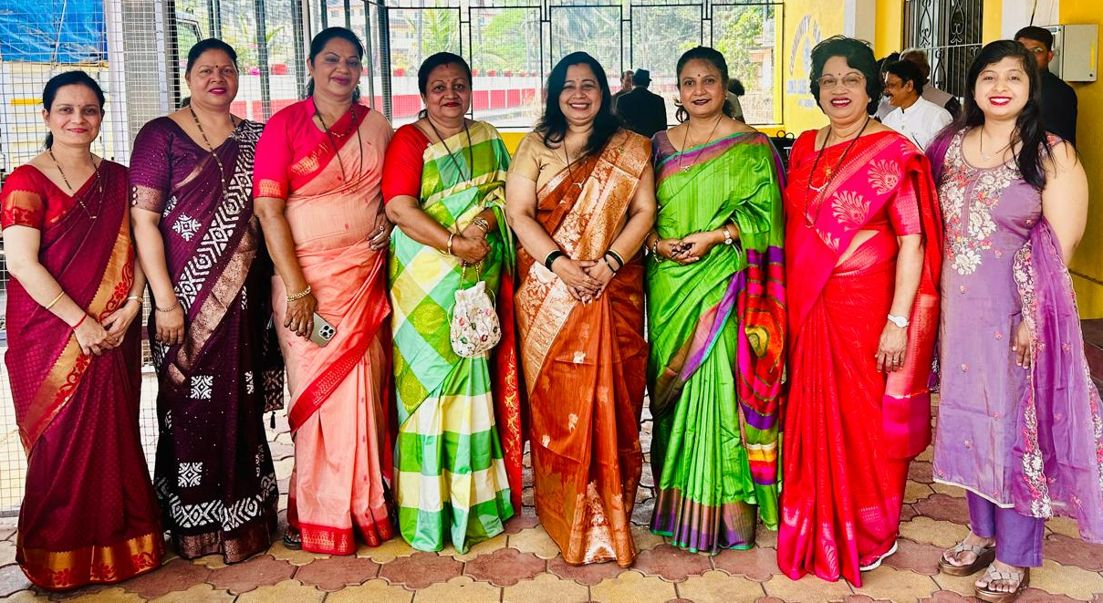
HOLI CELEBRATION AT CLUB PREMISES
Date : 4th March 2026
On the occasion of HOLI, Festival of Colour which was celebrated in the Club House, Sweets were distributed and Competition on colourful saree wearing was organized, The best colourful Saree wearing lady was given an award.

