Slide 1
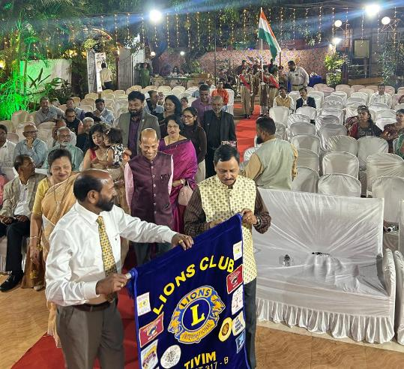
“REGION CONFERENCE” REGION-IV DISTRICT-317B
Date : 1st March 2026
Hosted Region Conference 2026 of Region IV District 317B at “Good Food” Open Air Hall. Marcel
Ln MJF Prashant Chanekar chaired this conference
17 members of the Club registered and actively participated to make this conference a success
Members actively participated in Club Flag March

Slide 2
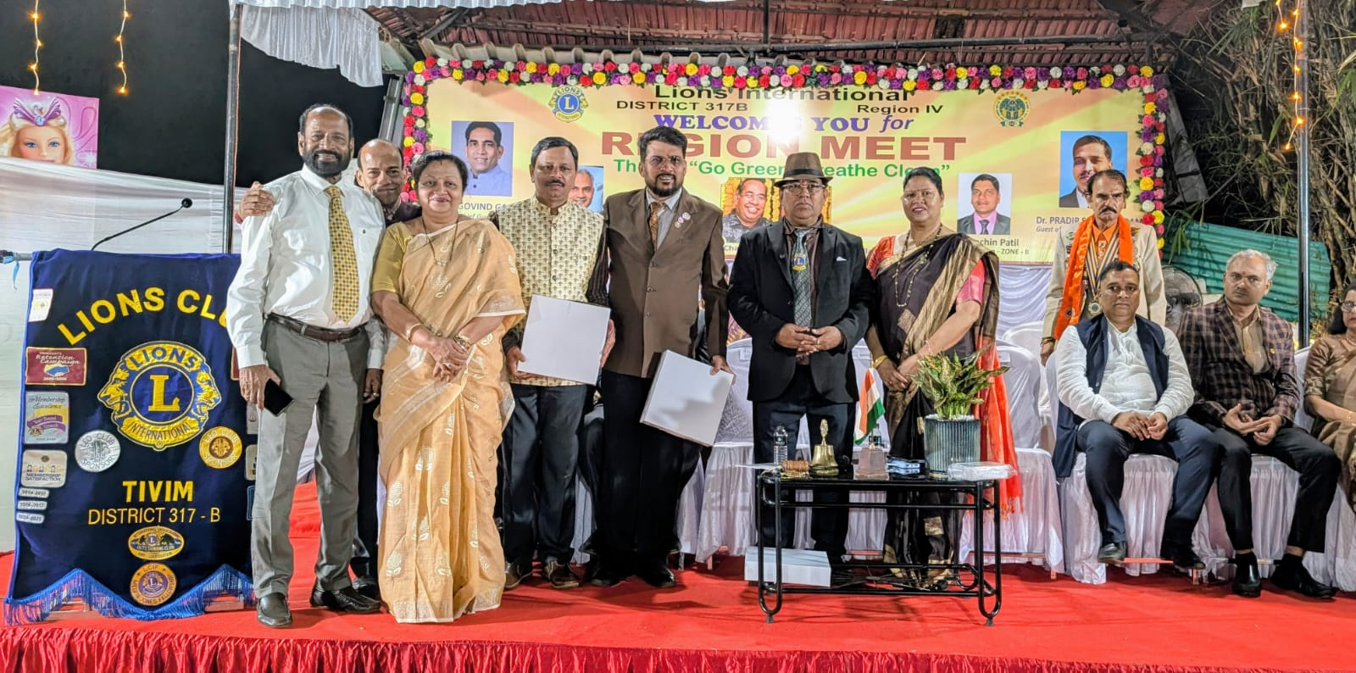
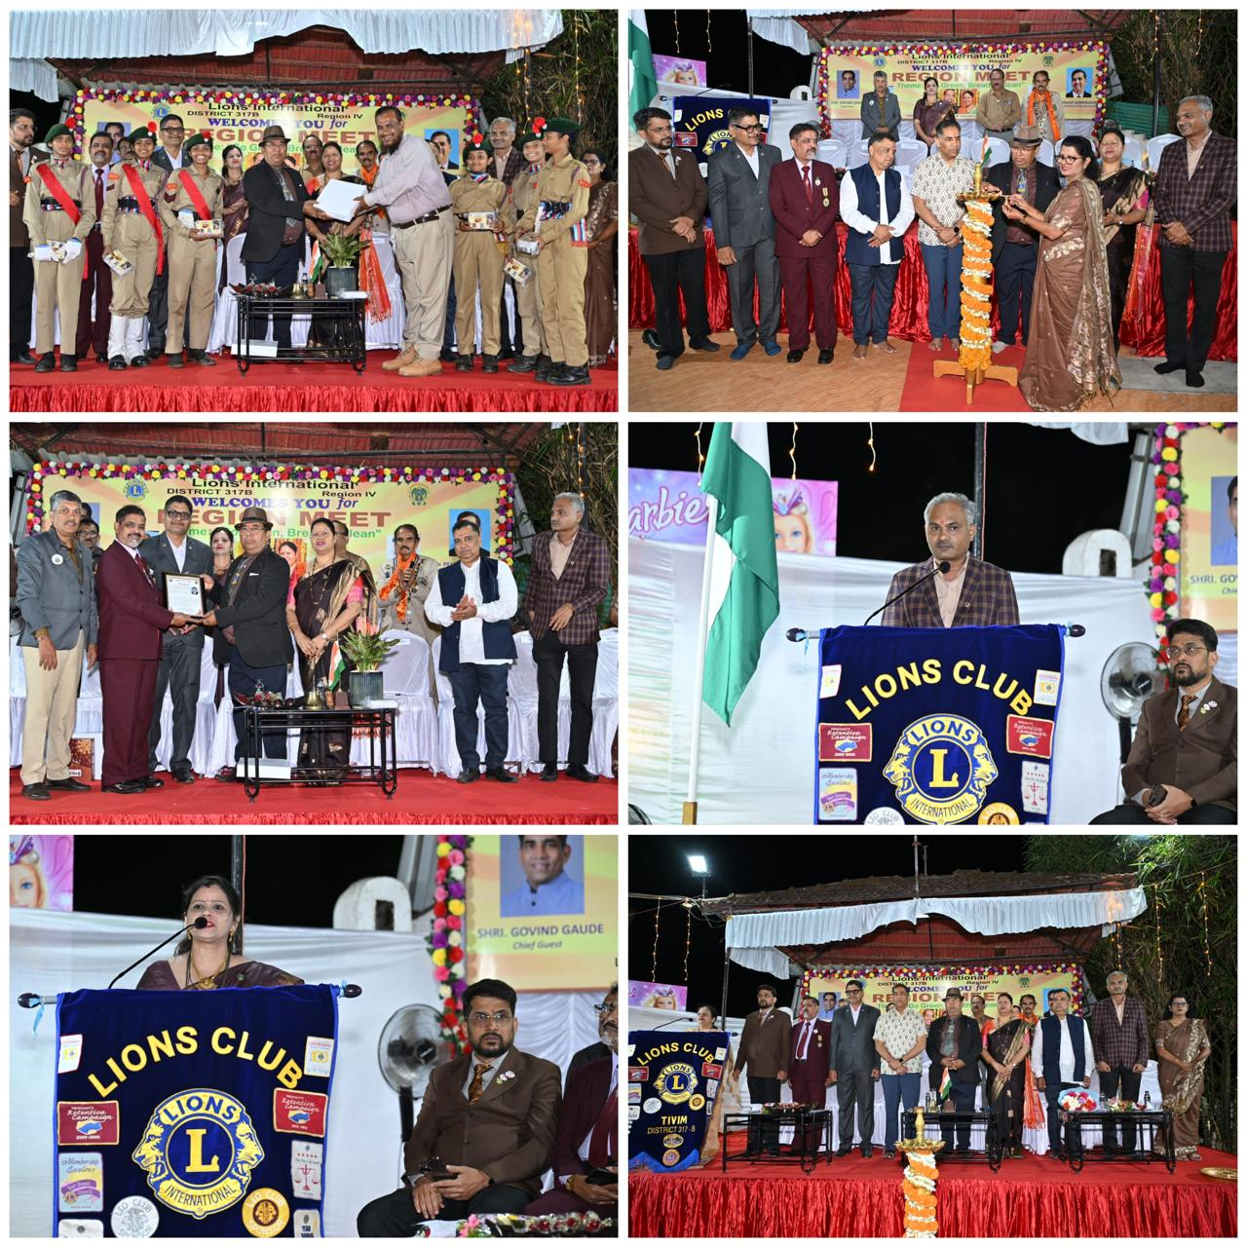
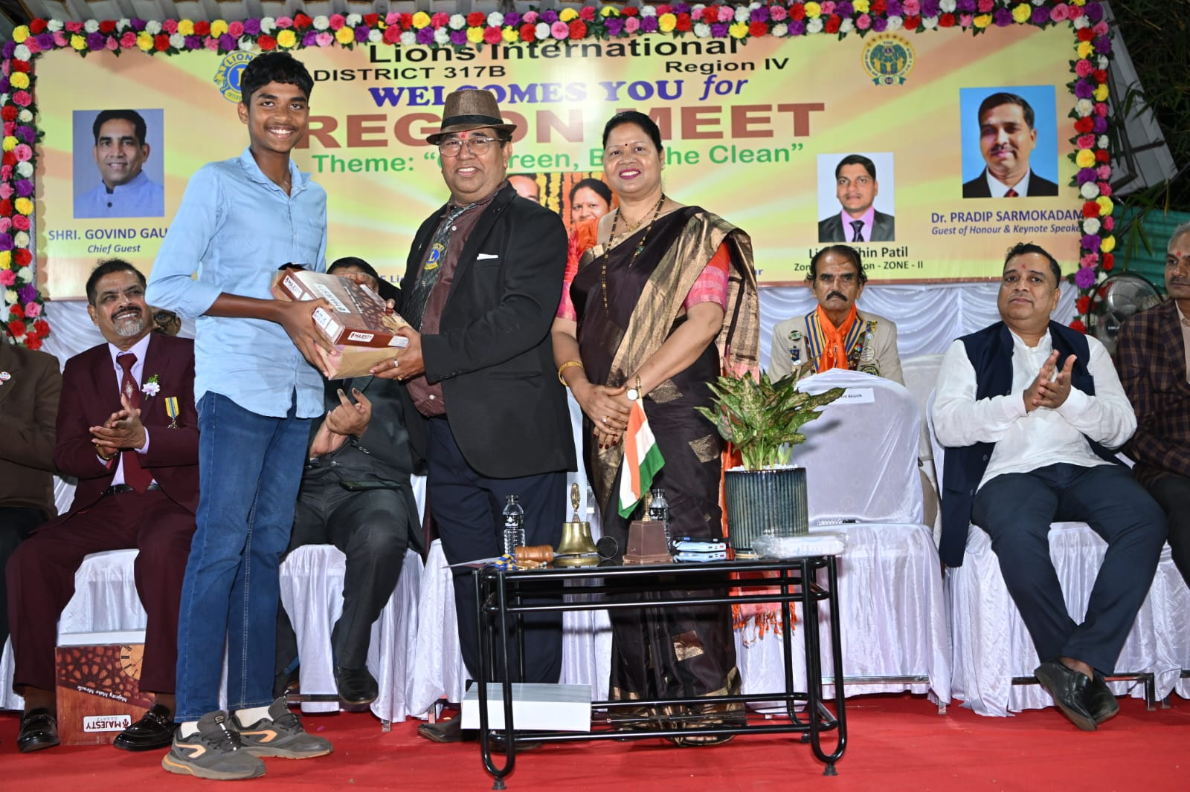
Club won Appreciation Awards for the Region Chairperson
Glimpses of the Region Conference hosted by the Clun

